Slide 1


Assessment and Evaluation in Digital Education: Open Digital Badges
Sirje Virkus (sirje.virkus@tlu.ee) https://www.assistant-erasmus.eu

Slide 2


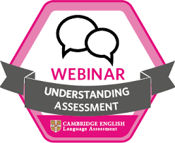
What are Open Badges (OB)?
Open Badges or Digital Badges are visual symbols that provide a validated indicator of achievements and communicate skills and knowledge packed with data and evidence that can be shared across the web.
Open badges empower individuals to take their learning with them, wherever they go, building a rich picture of their lifelong learning journey (https://openbadges.org/).

Slide 3

Open Digital Badges

Slide 4
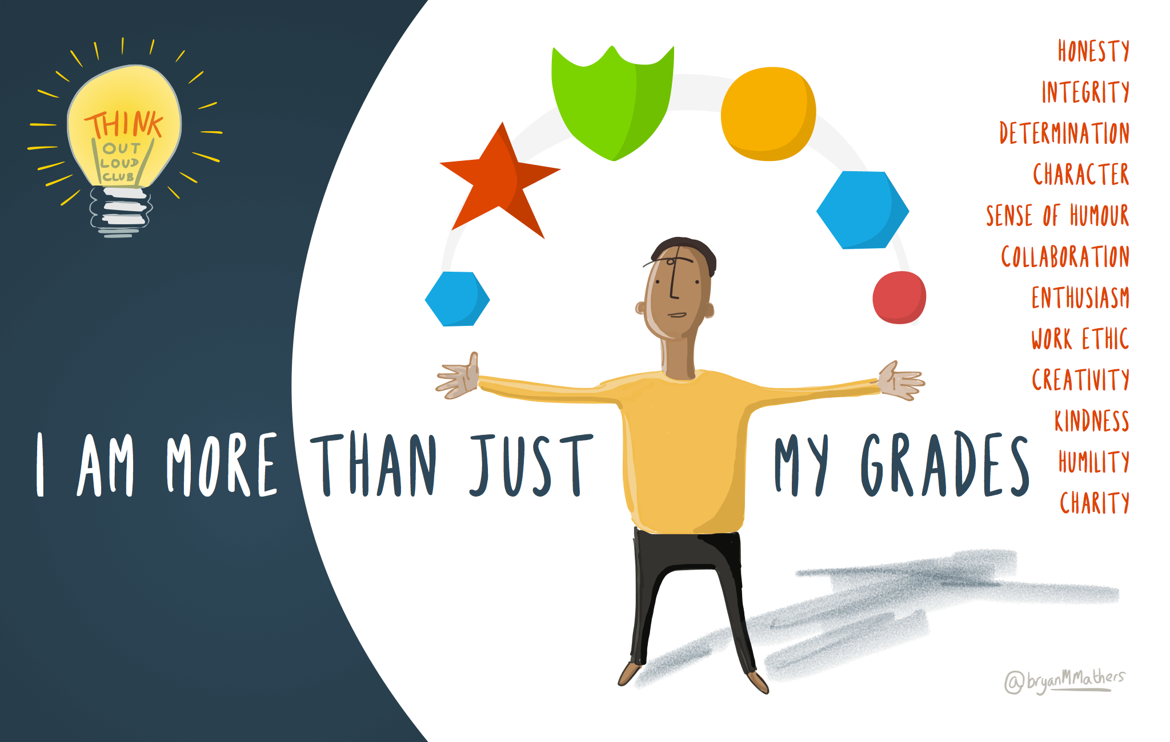
Open Digital Badges

Slide 5
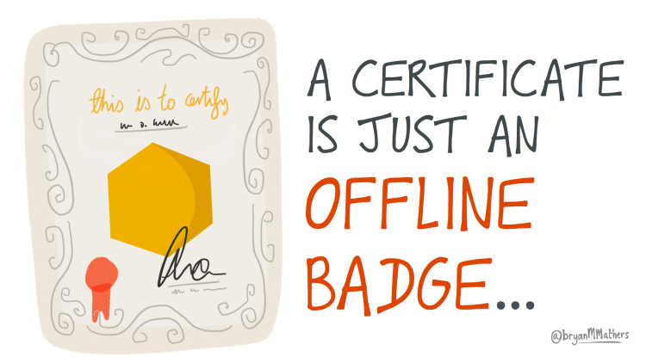

Open Digital Badges

Slide 6
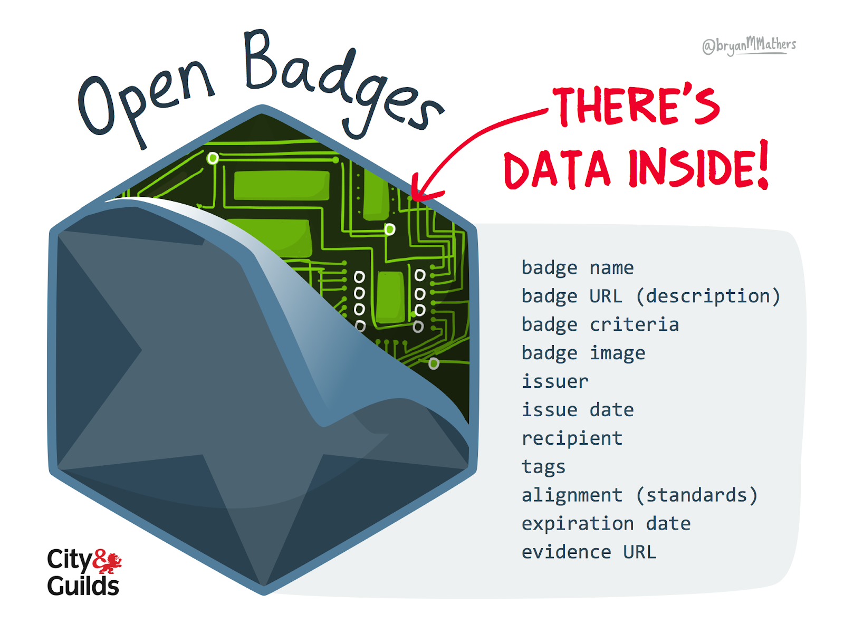
Open Digital Badges

Slide 7
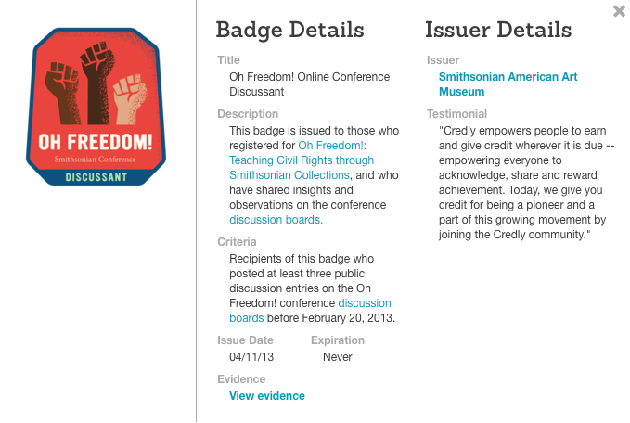
Open Digital Badges

Slide 8
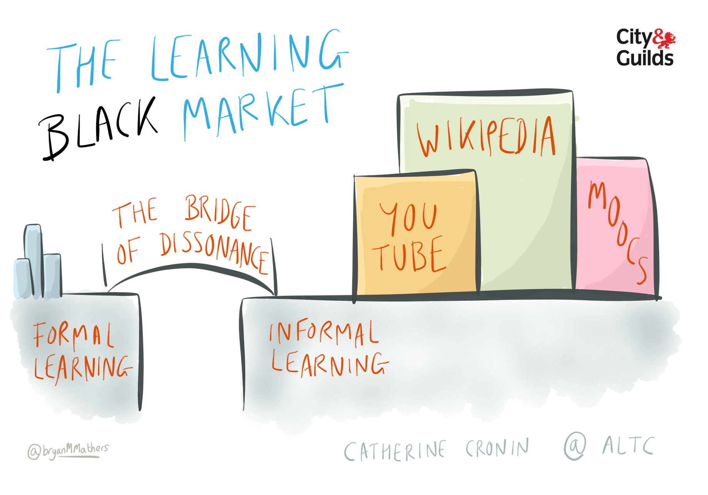
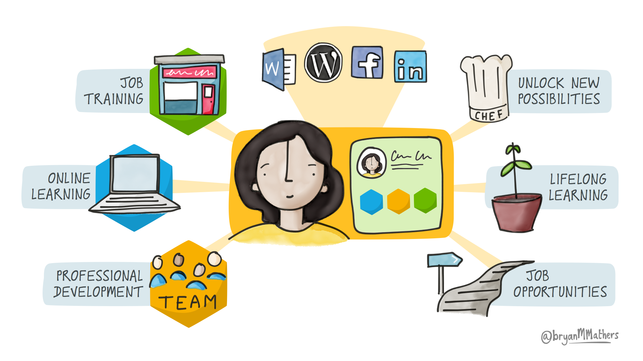
Open Digital Badges

Slide 9
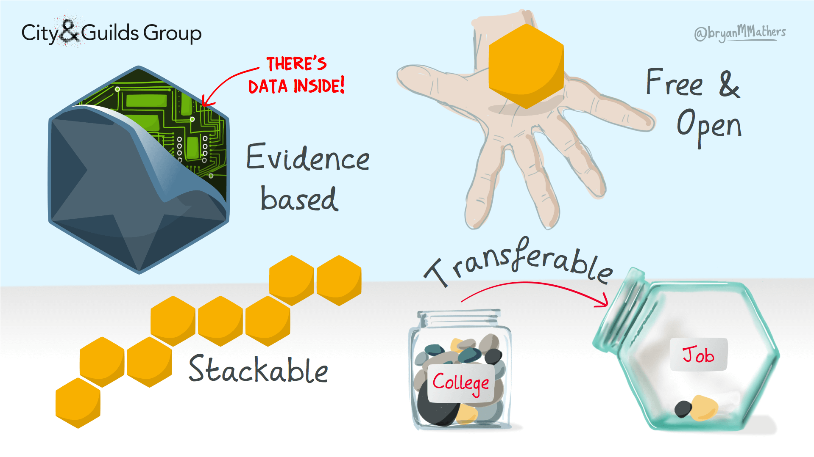
Open Digital Badges

Slide 10
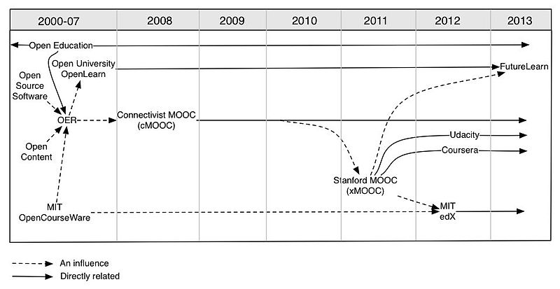
Open Education

Slide 11
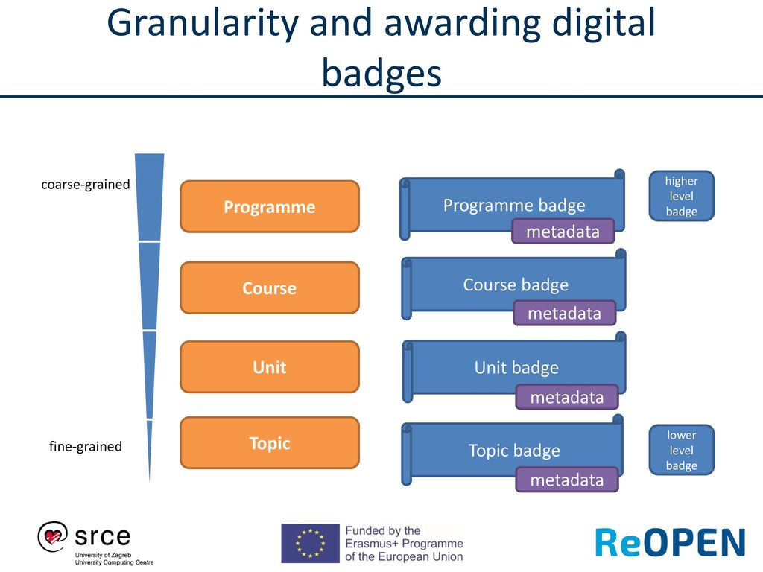
Open Digital Badges

Slide 12
Types of Open Digital Badges
There are many types of Open Badges:
Outcome-Based Badges
    Basic Knowledge badges
    Skills badges
    Advanced Knowledge badges
Multiple level of badges (e.g. regular badges, golden badges; Gold, Silver, Bronze)
Multiple Learning Pathways (Researcher, Practitioner, Wikipedist)
Broken badges: are used to point out unwanted behaviour (e.g. being late with the assignments).
Deconstructed badges: large learning activities should be deconstructed into separate independent badges (e.g. peer review badge for the literature review assignment).

Slide 13
Learner’s Perspective on OB
support learners with different learning styles (e.g. Activist, Reﬂector, Theorist, Pragmatist by Honey & Mumford, 1992).
help learners to plan their learning goals and strategies (learning contract);
learners can choose their own learning paths:
  some learners can create learning objects,
  some write a literature review or an essay
  some can develop podcasts or videos, etc.
could be used for self-assessment.
Open badges, multiple learning pathways and personal learning contracts form a triangle of educational tools that complement each other when used together.

Slide 14


Thank you for attention

