Slide 1


Assessment and Evaluation in Digital Education: The Importance of Feedback in Online Learning
Sirje Virkus (sirje.virkus@tlu.ee) https://www.assistant-erasmus.eu

Slide 2

Introduction
  The role of feedback in student learning
  Promoting a growth mindset through feedback
  Bridging the gap between performance and learning outcomes

Slide 3
Purpose of the Feedback
Feedback is a powerful construct in the design of quality online learning, and quantified dimensions of learners’ feedback experiences can be leveraged to improve effectiveness, increase efficiency, and maintain appeal in online courses.
Feedback should stimulate reflection, thought, learning, and improvement.
Feedback and assessment go hand in hand. Learner-centered feedback is an essential component of quality assessment, which is part of the learning process.

Slide 4
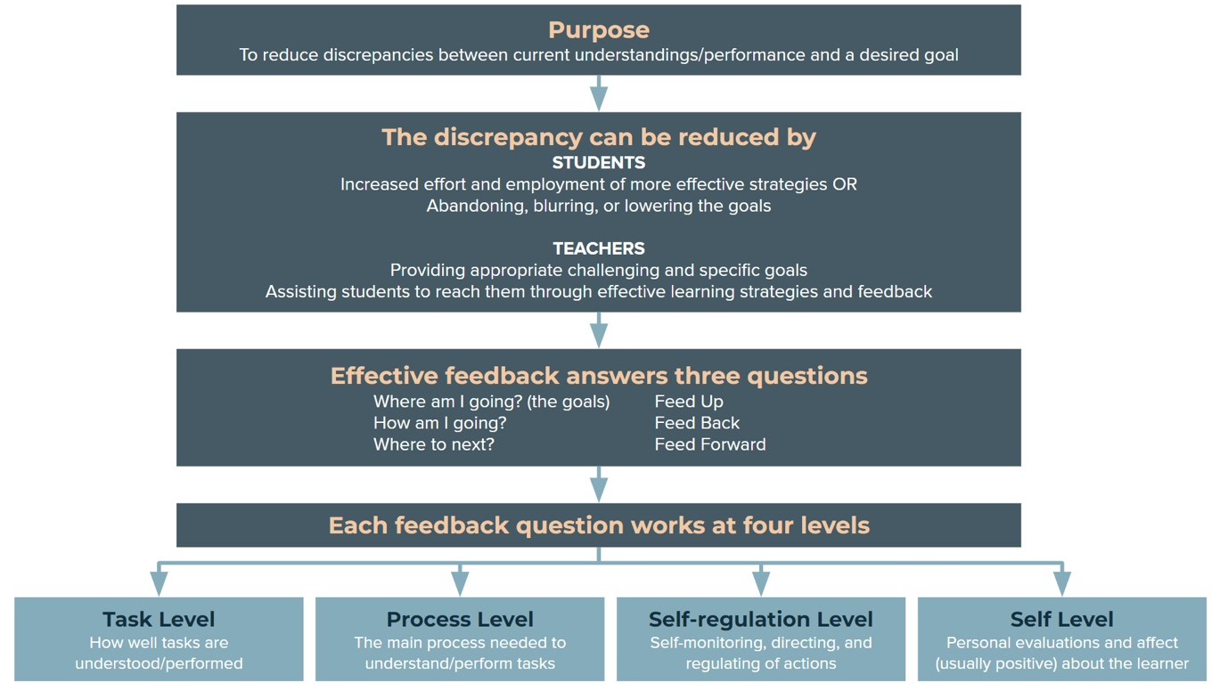
A Model of Feedback to Enhance Learning
Hattie & Timperley, 2007

Slide 5
A Model of Feedback to Enhance Learning
A model presents a framework in which feedback can be considered;
The model identifies three major feedback questions:
Where am I going?
How am I going?
Where to next?
Hattie, J., & Timperley, H. (2007). The Power of Feedback. Review of Educational Research, 77(1), 81-112.

Slide 6

Dimensions of Feedback
  Timeliness of feedback
  Frequency of feedback
  Distribution of feedback interactions
  Source credibility of feedback
  Individualization of feedback
  Content usefulness of feedback

Slide 7
Dimensions of Feedback (1)
Timeliness: How quickly is feedback provided to the learner? The length of time between a learner’s attempt and the response of either a peer or instructor;
Frequency: How often is feedback received? The number of feedback instances experienced by the learner in a given unit;
Distribution: To what extent are interactions disbursed throughout the experience? The interval of time between feedback instances;

Slide 8
Dimensions of Feedback (2)
Source: To what extent does the learner trust the source of the feedback? The provider of the feedback is trusted by the learner;
Individualization: To what extent is the feedback connected to the learner’s unique strengths, needs or interests? The learner perceives that feedback is specific to his/her goals, strengths, needs, or questions;
Content: To what extent is the content of the feedback useful for the learner? The content of the feedback provides the learner with next steps to correct misunderstandings or prompts the learner to extend their learning in some new and novel way.

Slide 9

Perspectives of Feedback
  Microscope Lens: Detailed characteristics of feedback
  Camera Lens: Feedback as a snapshot of the learning process
  Telescope Lens: Long-term impact of feedback

Slide 10

Characteristics of Good Feedback
  Focus on specific learning objectives
  Providing actionable suggestions
  Encouraging student reflection
  Timely and respectful delivery
  Offering praise and recognition

Slide 11

Forms of Feedback
  Written feedback
  Verbal feedback
  Peer feedback
  Self-assessment
  Automatic feedback generation in online learning environments

Slide 12

Designing Feedback Strategies
  Elements of an effective feedback strategy
  Clear learning objectives and ongoing assessment
  Timely feedback and self-reflection
  Goal setting and action planning

Slide 13
Methods Suitable For E-feedback
Feedback is the comments, questions, and information on how students are achieving predetermined goal.
Feedback methods are not discipline-specific, they are context- dependent.
Automated tutors
Auto-scoring of assignments
Self-checks
Written comments
Oral comments
Meta-verbal
Emoticons
Costello, J., & Crane, D. (2016). Effective Feedback in Online Learning..

Slide 14
Methods Suitable for E-feedback
Automated tutors
Auto-scoring
computer-generated comments based on background programming;
model answers or programmed feedback given in response to answers submitted to learners on computer-based assessments.
auto-scoring of assignments is used in educational games, or computer marked tests;
differs from the automated tutor in that a score is provided;
requires background programming.

Slide 15
Methods Suitable for E-feedback
Oral comments
Written comments
spoken words, such as those used in group discussions;
may be synchronous or asynchronous comments.
texted-based comments placed on learner’s work that tells the learner what is good about their work as well as how the work may be improved.

Slide 16
Methods Suitable for E-feedback
Self-checks
Meta-verbal
involve the learner reviewing the objectives to ensure they know what they are expected to know;
self-checks are often found at the end of a chapter, or on the textbook’s associated website.
meta-verbal feedback is provided using body language, tone, etc., that provide more information than words alone.

Slide 17
Methods Suitable for E-feedback
Emoticons
Peer feedback
emoticons are word stamps, thumbs up, smiley faces or frowns that are quick and let the learner know what the teacher feels about a component of the work.
involves learners critically thinking about their work and the work of others in order to make suggestions on ways to improve.

Slide 18
Key Points to Consider when Providing Feedback
Clear - Will a learner be able to read, listen, or view? Understand?
Concince - Is there too much information to be absorbed?
Specific - Does the feedback focus on the outcomes and/ or rubrics?
Tone - Does the tone you chose to use encourage the learner?
Outcomes - Is the assignment based on course outcomes? Does your feedback focus on these?
Expectations - Are your expectations congruent with the outcomes? Does your feedback focus on these expectations?

Slide 19
Automatic Feedback Generation in Online Learning Environments
Main goals for using automatic feedback generation:
Use feedback to help students on a specific content/ course;
Use feedback to support self-regulation;
Use feedback to help instructors;
Use feedback to reduce plagiarism behavior.
Cavalcanti, A. P. et al. (2021). Automatic feedback in online learning environments: A systematic literature review. Computers and Education: Artificial Intelligence, 2, 100027.

Slide 20
RISE Model for Clear and Effective Feedback
Reflect: your overall evaluation of the work
Suggest: ideas for improving the current iteration of the work
Elevate: ideas for future work or for raising the current work
Inquire: additional information you are missing
https://www.risemodel.com/

Slide 21
Conclusion
Feedback is one of the most powerful influences on learning and achievement;
Feedback has no effect in a vacuum; to be powerful in its effect, there must be a learning context to which feedback is addressed.
Feedback is among the most critical influences on student learning.

Slide 22
References
Cavalcanti, A. P. Et al. (2021). Automatic feedback in online learning environments: A systematic literature review. Computers and Education: Artificial Intelligence, 2, 100027.
Costello, J., & Crane, D. (2016). Effective Feedback in Online Learning. In J. Keengwe, & G. Onchwari (Ed.), Handbook of Research on Active Learning and the Flipped Classroom Model in the Digital Age (pp. 212-231). IGI Global. https://doi-org.ezproxy.tlu.ee/10.4018/978-1-4666-9680-8.ch011
Crisp, E.A., Bonk, C.J. (2018). Defining the Learner Feedback Experience. TechTrends, 62, 585–593. https://doi.org/10.1007/s11528-018-0264-y
Hattie, J., & Timperley, H. (2007). The Power of Feedback. Review of Educational Research, 77(1), 81-112. https://doi.org/10.3102/003465430298487
Haughney, K., Wakeman, S., & Hart, L. (2020). Quality of Feedback in Higher Education: A Review of Literature. Education Sciences, 10(3), 60. MDPI AG. Retrieved from http://dx.doi.org/10.3390/educsci10030060

Slide 23


Thank you for attention

