Slide 1


Digital Tools for Education: Collaborative Tools and Applications
Sirje Virkus (sirje.virkus@tlu.ee) https://www.assistant-erasmus.eu

Slide 2

What is Collaboration?
The concept of collaboration lacks a universally accepted definition, being a construct that encompasses a myriad of definitions and frameworks (Patel et al., 2012).
The Cambridge English Dictionary defines collaborative working as “the act of two or more people or organizations working together for a particular purpose” (The Cambridge English Dictionary, 2023).

Slide 3

Types of Collaborative Work
  Synchronous vs. Asynchronous Collaboration
    Definitions and Examples
    Advantages and Challenges
  Team Collaboration vs. Project Collaboration
    Characteristics and Objectives
    Case Studies and Examples
3
Notes:
3

Slide 4

Networking and Collaboration Tools (1)
There are a variety of free and commercial collaboration and networking tools/platforms that support learning and teaching and allow teachers to share materials with their learners and work on them together in real time, or asynchronously.
This can enable strengthening of the teacher- learner online relationship, which is particularly valuable in the early stages of a course.
4
Notes:
4

Slide 5
Networking and Collaboration Tools (2)
In addition, a range of collaborative networking tools can be used to foster group working and a sense of community between learners on an online course.
Instant messaging apps can foster backchannels. Activities using Twitter or Pinterest to search for information, or using Diigo to gather together relevant internet bookmarks, can help bring an online group together with a shared objective, as well as exposing that group to a wider community in a relevant subject area (OU, 2017).
5
Notes:
5

Slide 6
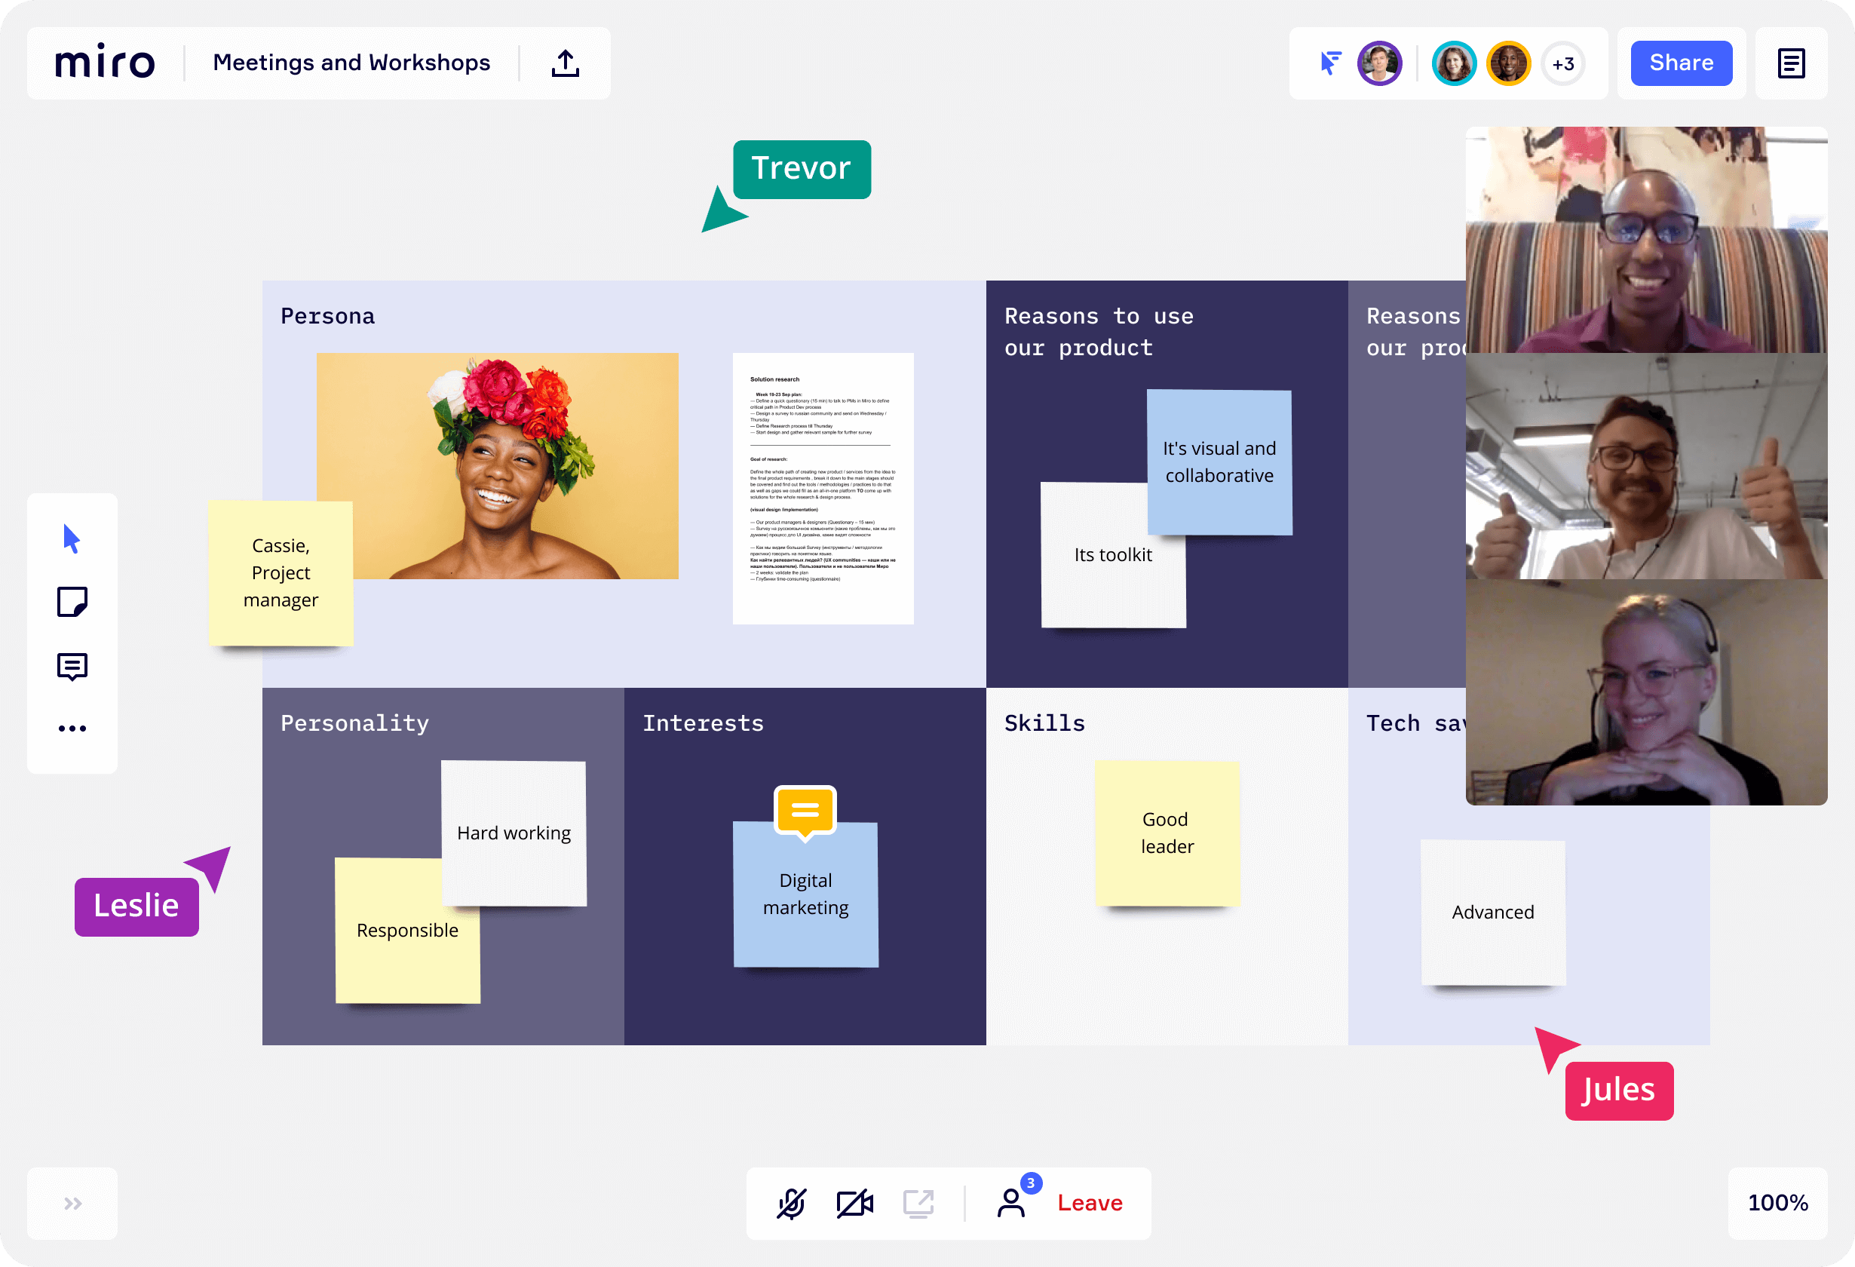

Miro
Miro is a whiteboard platform that is great for collaborative learning. This platform is excellent for structuring ideas while encouraging students and teams to collaborate.
Thanks to its intuitive and comprehendible design, teams can engage in brainstorming, plan activities, give/ask for feedback and suggestions, present different concepts, etc.
In addition, the platform comes with a chat, comment, and video section.
Miro is free for personal use only. The paid version costs $8 per user, monthly.
You can find out more about this platform in the following video Getting Started with Miro

Slide 7
Teachfloor
Teachfloor is a cohort-based collaborative learning platform that allows to make the learning experience engaging, collaborative, and interactive.
Enables creating, managing, and selling online cohort-based courses.
Combine synchronous and asynchronous communication.
Offers a 15-day trial period, after which you get to choose between the business and the pro tier. The pro tier (up to 100 students) costs $99 per month, whereas you get a custom quote for the business tier.
Benefits:
Create cohort-based learning in minute — not days.
Create a collaborative environment using peer learning.
Manage communities to encourage valuable discussions and connections.
Build an entire academy under your brand
Use Zoom to run, sync, and automate classes.
Cohort-based learning describes a learning style where a group of students (a ‘cohort’) take a series of classes together as a group. Students have the same learning schedules and deadlines as opposed to working at their own pace.

Slide 8
Nearpod
Nearpod is considered one of the best collaborative learning tools for interactive presentations and assessments.
Thanks to its intuitive interface, it is straightforward to create lessons and videos.
It is super-easy to upload learning materials from places such as YouTube, PowerPoint, and Google Slides.
Starting an interactive discussion is another thing designed to be easily accessible.
One just needs to click on some lesson slides, add a topic to that particular slide, and learners can respond to it the moment they reach it. Learners can give a video, audio, or textual response.
users can choose between three tiers: Silver (free), Golden ($120 per year), and Platinum ($349 per year).
You can find out more about this platform in the following video Nearpod for Teachers

Slide 9

Zoom
Zoom Webinars are useful for more one-way communication with a large size group (up to 500). Options for participants to communicate are restricted, making it more suitable for announcements and general information to a large group, rather than for two-way or small-scale collaboration.
In addition to its free tier, Zoom offers three more premium tiers: pro, business, and enterprise. The pro tier costs $14 per host monthly, whereas both the business and enterprise tiers cost $19 per host monthly.
Zoom is a synchronous virtual meeting tool supporting communication and collaboration using video, audio, screen-sharing and text chat, and include options to split groups into breakout rooms, audio and camera control, the ability to record meetings, virtual background, gallery and portrait views, and so on.
Can host up to 500 people at one video meeting.
Unlimited chat time is available only for paid accounts.
You can find out more about this platform in the following video Zoom tutorial 2022

Slide 10
Microsoft Teams
Pros
Full integration across Office 365 apps.
Ample cloud storage per user.
Provides access to Microsoft Office tools in one place.
Easy to use and safe platform.
Cons
The interface is fairly complicated.
Challenging to start.
Microsoft Teams is a unified collaboration and communications platform that merges chat with video meetings, file storage, attachments and app integration.
It supports synchronous and asynchronous activity via sharing of files, a number of different communication modes and a rich suite of integrated tools.
You can find out more about this platform in the following video Microsoft Teams Tutorial

Slide 11
Slack
Slack is a single platform that enables teams to collaborate on complex projects.
It offers a wide range of communication and productivity tools such as real-time messaging (chat and calls), integration with apps and bots, searchable conversations, searchable records, etc.
As a result, every team member is in the loop and is always up-to-date with things.
In addition to the free tier, Slack offers three more premium tiers: standard, plus, and enterprise grid.
The standard tier costs $6.67 per user monthly, the plus tier costs $12.50, whereas you can get a custom quote for the enterprise grid.
You can find out more about this platform in the following video Slack Review

Slide 12
Google Docs
Pros
Cloud based, no installations required.
All changes made on documents are automatically saved to Google Drive so you won’t lose them.
Multiple collaborators on a document can see changes in real time.
Cons
Limited features compared to Microsoft Word.
Google Docs allows multiple people to edit the same file at same time, leave comments, and see changes made by every participant (revision history).
All you have to do is invite team members to work on a file in Google docs. With that, all participants have a central place to store and share information, take notes, and just seamlessly collaborate and have access to the information they need to get work done.
You can find out more about this platform in the following video How to Use Google Docs

Slide 13
Google Workspace
Depending on edition Google Workspace may also include the digital interactive whiteboard Jamboard and an option to purchase such add-ons as the telephony service Voice.
The education edition adds a learning platform Google Classroom and today has the name Workspace for Education.
Google Workspace (formerly known as Google Apps and later G Suite) is a collection of cloud computing, productivity and collaboration tools, software and products developed and marketed by Google.
Google Workspace consists of Gmail, Contacts, Calendar, Meet and Chat for communication; Currents for employee engagement; Drive for storage; and the Google Docs suite for content creation.
You can find out more about this platform in the following video What is Google Workspace?

Slide 14
Perusall
Perusall is a social reading platform integrated into Moodle that allows students (and teaching staff) to digitally annotate readings and videos collaboratively (with text, links, and embedded content), and respond to each other’s comments and questions.
The Perusall platform is free for students, instructors, and educational institutions.
Based on extensive (patent-pending) data analytics, behavioral science, and educational research
Developed at Harvard by Gary King, Brian Lukoff, Eric Mazur, Kelly Miller
You can find out more about this platform in the following video Introduction to Perusall

Slide 15

Engaging Students and Building Community
  Importance of Student Engagement
    Cognitive Engagement
    Emotional Engagement
    Behavioral Engagement
  Building a Learning Community
    Inclusive Environment
    Collaborative Learning
    Faculty-Student Interaction
    Extracurricular Activities
  Strategies for Engagement and Community Building
    Active Learning Techniques
    Technology Integration
    Feedback and Assessment
    Professional Development for Educators
    Community Building Activities
15

Slide 16
References
Birkeland, N. R., Drange, E. M. D., & Tønnessen, E. S. (2015). Digital collaboration inside and outside educational systems. E-Learning and Digital Media, 12(2), 226-241.
Lee, T., Pham, K., Crosby, A., & Peterson, J. F. (2021). Digital collaboration in design education: how online collaborative software changes the practices and places of learning. Pedagogy, Culture & Society, 29(2), 231-245.
Virkus, S. (2024). Collaborative Working, Crowdsourcing, Partnering and Networking. Encyclopedia of Libraries, Librarianship, and Information Science. Academic Press.
Virkus, S. (2007). Collaboration in LIS education in Europe: Challenges and opportunities. In Proceedings of the World Library and Information Congress: 73rd IFLA General Conference and Council. Libraries for the future: Progress, Development and Partnerships (pp. 19-23).
Zawacki-Richter, O., & Jung, I. (Eds.). (2023). Handbook of Open, Distance and Digital Education. Springer.

Slide 17


Thank you for attention

