Slide 1


Digital Tools for Education: Learning Management Systems
Sirje Virkus (sirje.virkus@tlu.ee) https://www.assistant-erasmus.eu

Slide 2

Introduction
  Overview of digital technologies in education
  Definition and purpose of Learning Management Systems (LMS)
  Importance of LMS in contemporary education
2
Notes:
2

Slide 3

Learning Management Systems: Definition
Learning Management System is a software tool that allows you to create, deliver, and report on training courses and programs.
There are many LMSs to choose from, each offering different features and capabilities. Every company has different training needs, making identifying and selecting the ‘right’ LMS a daunting process.
Photo made by Bing Image Generator

Slide 4
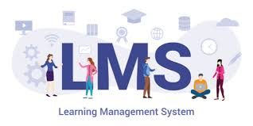
Historical Context and Evolution
  Early developments in educational technology
  Key milestones in the evolution of LMS
  Transition from Computer-Based Training (CBT) to modern LMS
  Impact of the internet on LMS development
  Introduction and significance of SCORM
  Emergence of mobile LMS and current trends
4
Notes:
4

Slide 5
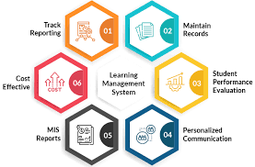
Key Features and Functionalities
Course Creation and Management
User Management
Assessment and Evaluation
Communication Tools
Tracking, Analytics and Reporting
Customization and Personalization
Benefits of LMS in online teaching
5
Notes:
5

Slide 6
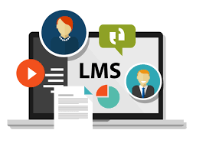
Impact on Educational Practices
  Accessibility and flexibility
  Enhanced engagement
  Data-driven insights
  Scalability and democratization of education
6
Notes:
6

Slide 7

Popular LMS Platforms
Moodle
Blackboard Learn
Canvas by Instructure
Google Classroom
Schoology Learning
TalentLMS
Edmodo
D2L Brightspace
SAP Litmos
Adobe Learning Manager
7
Notes:
7

Slide 8

Implementing an LMS
Needs Assessment
Selecting the Right Platform
Installation and Setup
Customization and Branding
8
Notes:
8

Slide 9

Content Creation for LMS
Designing Engaging Content
Multimedia Integration
Copyright and Fair Use
9

Slide 10

User Engagement and Motivation
Gamification Strategies
Collaborative Learning
Feedback and Support
10

Slide 11

Assessment and Evaluation
Types of Assessments (Quizzes, Assignments, Discussions)
Grading and Feedback Mechanisms
Analysing Student Performance
11

Slide 12

LMS Administration and Maintenance
Regular Updates and Upgrades
User Support and Troubleshooting
Security and Privacy Considerations
12

Slide 13

Challenges and Considerations
  Intuitive User Experience (UX)
  Integrating with Other Systems
  Keeping Content Relevant and Updated
  Scalability Concerns
  Technical Glitches and Downtimes
  Data Security and Privacy
  Tracking and Reporting Limitations
  Mobile Accessibility
  Customization Restrictions
  Cost Management
13
Notes:
13

Slide 14

Future Trends in LMS
Automated content generation;
Adaptive learning paths;
Personalized assessment tools;
Skill gap analysis;
Intelligent grading and feedback;
Virtual tutors and chatbots;
Learning resource recommendations (Kapadia, 2024).
14
Notes:
14

Slide 15
References
Kapadia, V. (2024). The History and Evolution of Learning Management Systems. https://www.gyrus.com/blogs/the-history-and-evolution-of-learning-management-systems/
Next Generation eDucation (2023). Top 10 Challenges of Managing a Learning Management System (LMS) https://www.linkedin.com/pulse/top-10-challenges-managing-learning-management-system-lms-greenlms-fv0tf/
Paulsen, M. F. (2003). Experiences with learning management systems in 113 European institutions. Journal of Educational Technology & Society, 6(4), 134-148.
Sankey, M. D., & Marshall, S. J. (2023). Perspective chapter: the learning management system of 2028 and how we start planning for this now. In Higher Education-Reflections From the Field-Volume 2. IntechOpen.
Turnbull, D., Chugh, R., & Luck, J. (2020). Learning management systems, an overview. Encyclopedia of Education and Information Technologies, 1052-1058.
Weller, M. (2023). The Rise and Development of Digital Education. In Handbook of Open, Distance and Digital Education (pp. 1-17). Singapore: Springer Nature Singapore.
Zawacki-Richter, O., & Jung, I. (Eds.). (2023). Handbook of Open, Distance and Digital Education. Springer.

Slide 16


Thank you for attention

