Slide 1


Lesson 2.3 Pedagogical approaches for online teaching
Pedagogical Approaches for Online Teaching
Sirje Virkus (sirje.virkus@tlu.ee) https://www.assistant-erasmus.eu

Slide 2
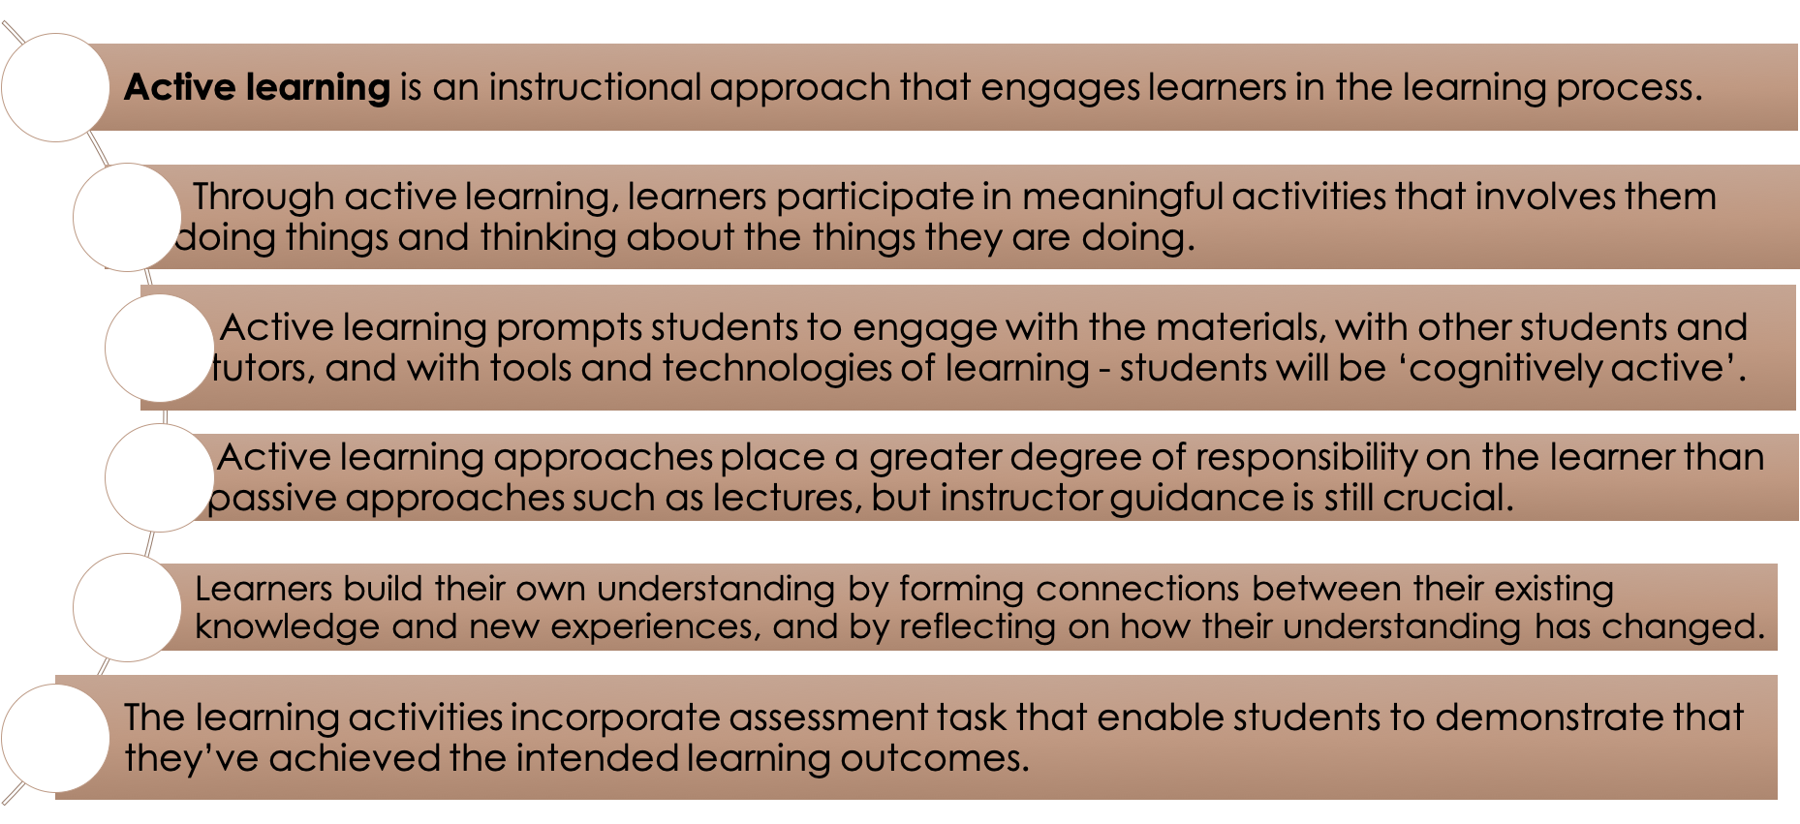
Active Learning

Slide 3
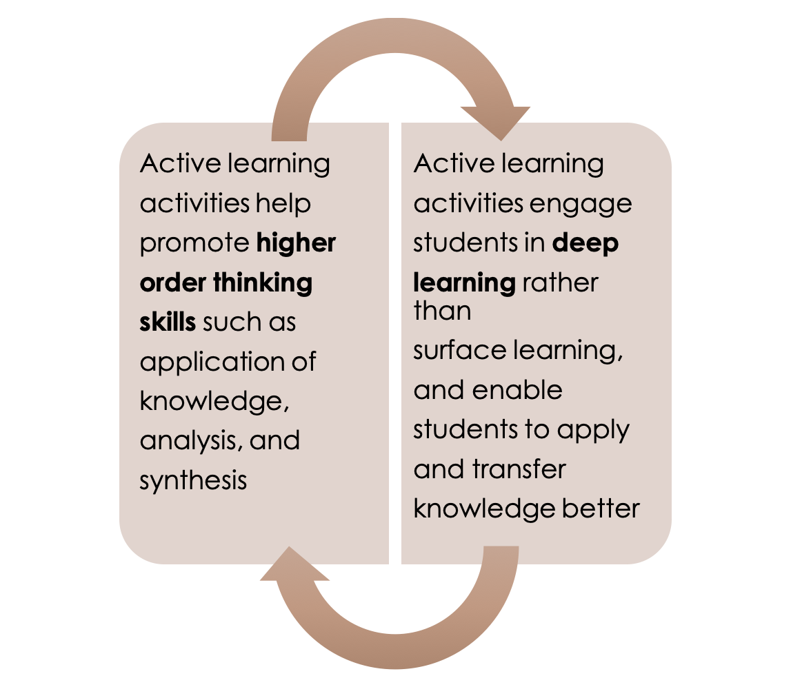
Active Learning
Active learning doesn’t simply make learning more interesting for students. It also promotes:
  higher-level thinking (Brown, 2014),
  independent study skills,
  communication skills and
  problem-solving abilities (Sivan et al., 2000).
These skills are transferable to work, further study and personal and professional life, and will set students up for whatever they choose to do next (OU, n.d.).

Slide 4
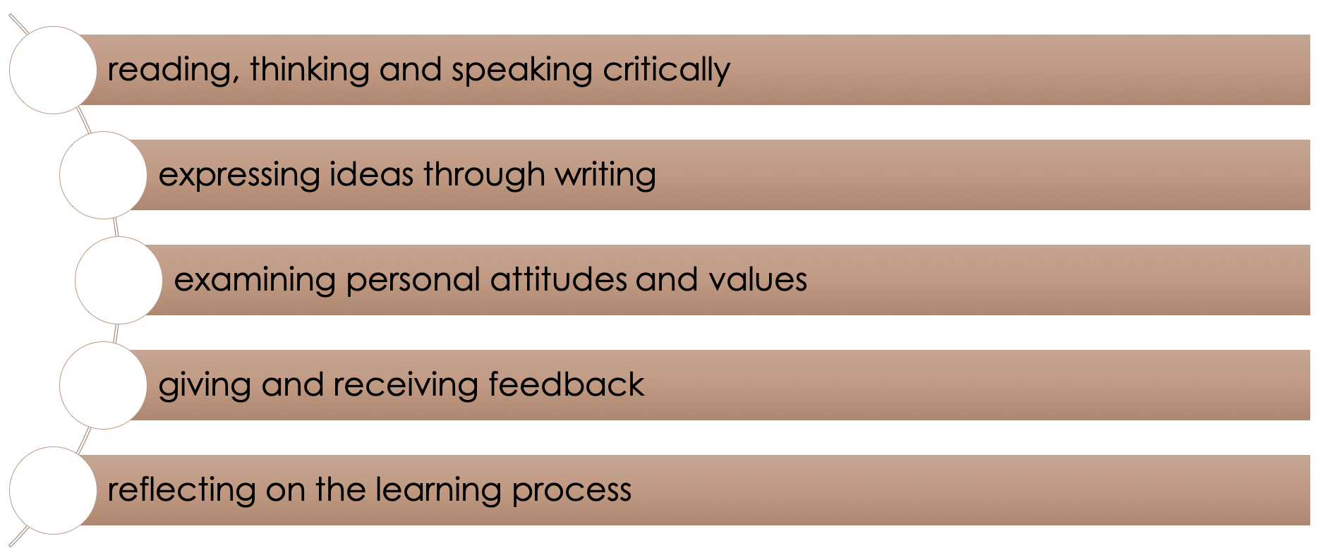
Types of Active Learning

Slide 5
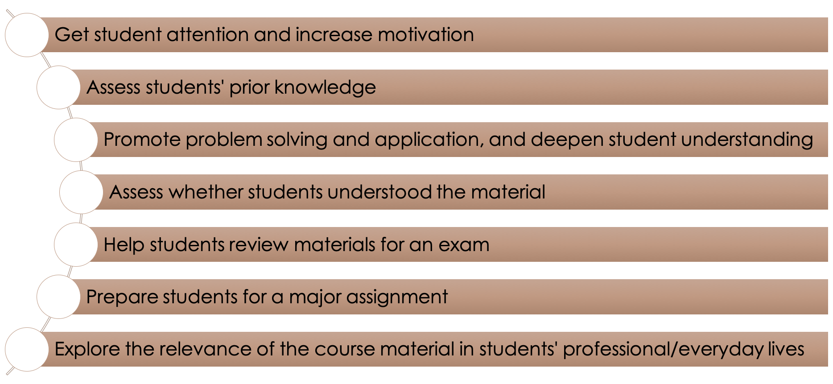
Active Learning Activities Can Be Used to:

Slide 6
Developing Active Learning from the Start
Active learning is particularly important in online education, where students aren’t in the same location as their peers.
Instructors should start thinking about active learning from the moment they start planning their online learning materials and incorporate strategies to encourage active learning, application, interaction, participation, and collaboration in the online environment.
In an active learning environment learners are immersed in experiences within which they engage in meaning-making inquiry, action, imagination, invention, interaction, hypothesizing and personal reflection (Cranton, 2012).

Slide 7
Developing Active Learning from the Start
Active learning is about what the student does rather than what the teacher does (OU, n.d.).
Most of the activities should be designed to prompt students not simply to read, see or listen to information but to search for it, process it, discuss it, present it, reflect on it, and apply it in real or simulated scenarios to which they can relate.
Incorporating active learning in online learning environments is crucial because it includes collaboration, exchanging ideas, and fostering an inclusive environment.

Slide 8
Active Learning Strategies
There are a variety of active learning strategies described in the literature.
Many university websites provide lists, guides, and resources for active learning strategies.
Iowa State University Center for Excellence in Learning and Teaching presents 226 Active Learning Strategies;
Purdue University offers Active Learning Strategies and Resources
University of Leicester active learning strategies

Slide 9
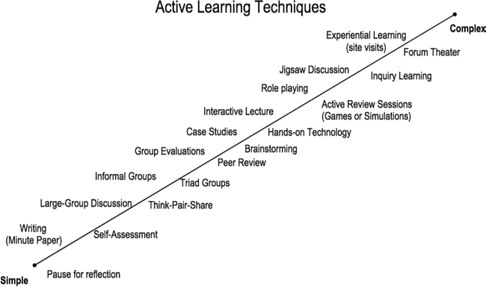
Active Learning Techniques
There are a broad range of active learning techniques that can be integrated into online courses.
Source: Chris O’Neal and Tershia Pinder-Grove, Center for Learning and Teaching, University of Michigan

Slide 10
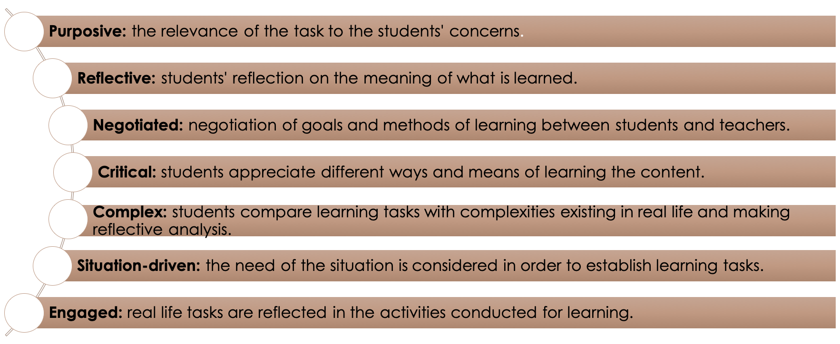
Principles of Active Learning

Slide 11
Instructional Design of Online Courses and Active Learning
The instructional design of online courses, taken together with active learning, deals with motivation, challenge, individual learning preferences, and social interaction.
When instructors incorporate active learning techniques closely tied to desired learning outcomes, they can transform practical experiences into the online classroom environment.

Slide 12
Instructional Design of Online Courses and Active Learning
Experiential opportunities create authentic opportunities for sharing and transferring knowledge of information to learners in order to meet the required course learning performance goals and standards.
These examples cultivate learner development, build on learners’ previous knowledge, and help learners develop in-depth knowledge and enhance team building, problem-solving, analysis, and critical thinking skills. In this section we shared just a few ways faculty can engage learners by incorporating active and experiential learning activities into online courses.

Slide 13
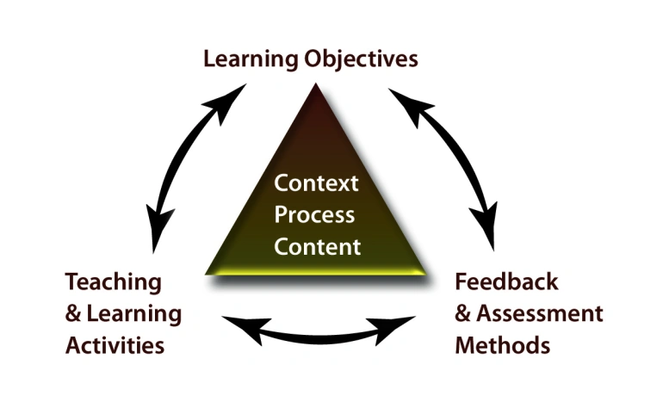
Constructive Alignment
Course Units are designed so that the Learning Activities and Assessments are aligned with one another and support and measure students' achievement of the unit's Intended Learning Outcomes (ILOs).

Slide 14
Constructive Alignment
Course Units are designed so that the Learning Activities and Assessments are aligned with one another and support and measure students' achievement of the unit's Intended Learning Outcomes (ILOs).
"Constructive alignment is a design for teaching in which what it is intended students should learn and how they should express their learning is clearly stated before teaching takes place. Teaching is then designed to engage students in learning activities that optimise their chances of achieving those outcomes, and assessment tasks are designed to enable clear judgments as to how well those outcomes have been attained" (Biggs, 2014, pp. 5-6).

Slide 15
Constructive Alignment
Alignment occurs when the learning activities that we ask students to engage in help them to develop the knowledge, skills and understandings intended for the unit and measured by our assessment.
A constructively aligned unit capitalises on the powerful effect of assessment on students' learning experiences.
If assessment drives students' learning, then students are most likely to achieve our intended outcomes if the assessment is aligned with our intentions.

Slide 16
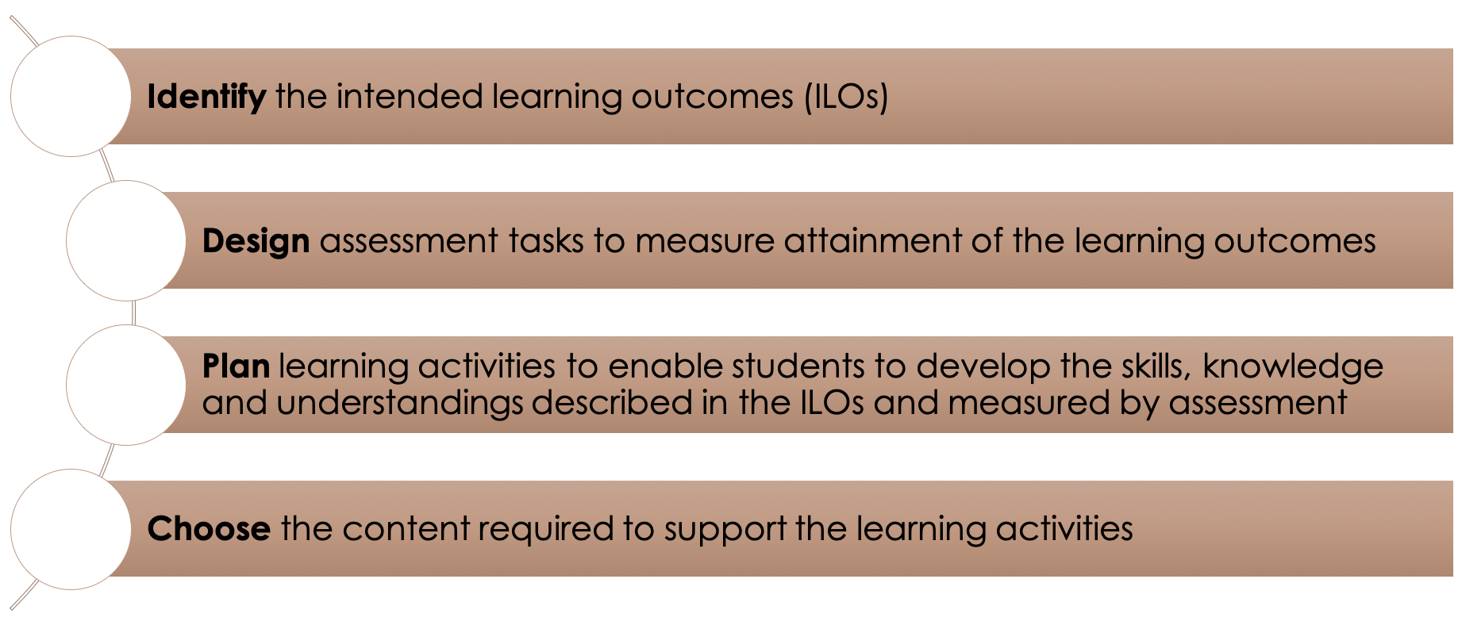
The Framework of Constructive Alignment
:

Slide 17
Strategies to Course Design
Create an open and safe environment.
Set a goal for the activity.
Choose the right exercise.
Identify preparation for the exercise.
Consider links to other class elements.
Plan how you will introduce the activity.
Plan the logistics.
Consider how you will judge success.
Just do it.
Iterate and expand (Active Learning Cheat Sheet. 10 Steps to getting started).
Understand Your Students
Set a Clear Objective for the Lesson
Incorporate Visuals, Visuals, and More Visuals
Keep Your Teaching Modules Short
Keep a Clear and Consistent Structure
Add Assignments and Homework
Evaluate, Reflect and Revise (How to Plan Effective Lessons for Your Online Classroom).

Slide 18
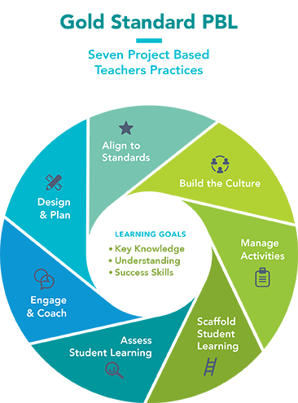
Strategies to Course Design
Design & Plan
Align to Standards
Build the Culture
Manage Activities
Scaffold Student Learning
Assess Student Learning
Engage & Coach
Source: Buck Institute for Education, Creative Commons

Slide 19
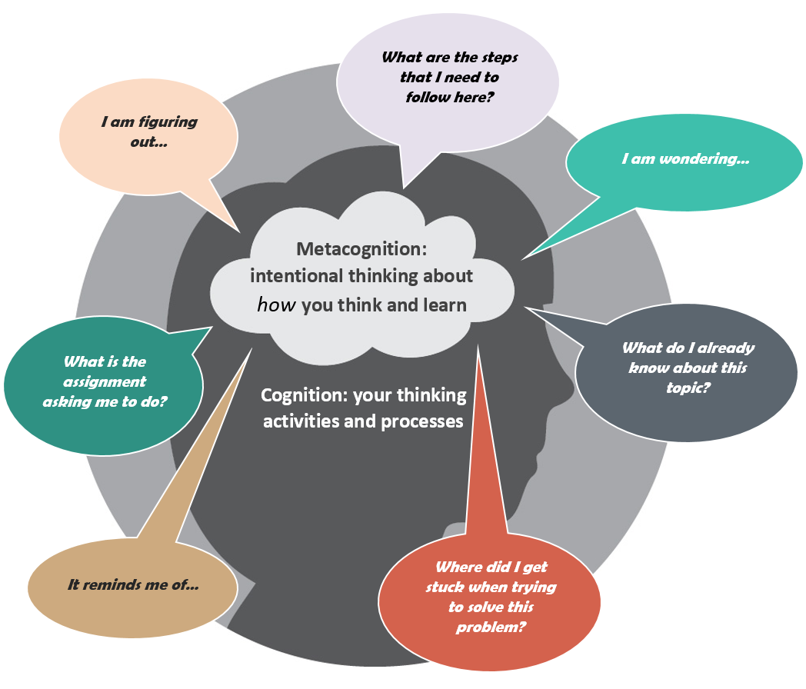
Metacognition
Metacognition is the ability to examine how you process thoughts and feelings.
This ability encourages students to understand how they learn best.
It also helps them to develop self-awareness skills that become important as they get older.
Image Source: https://www.queensu.ca/teachingandlearning/modules/students/24_metacognition.html

Slide 20
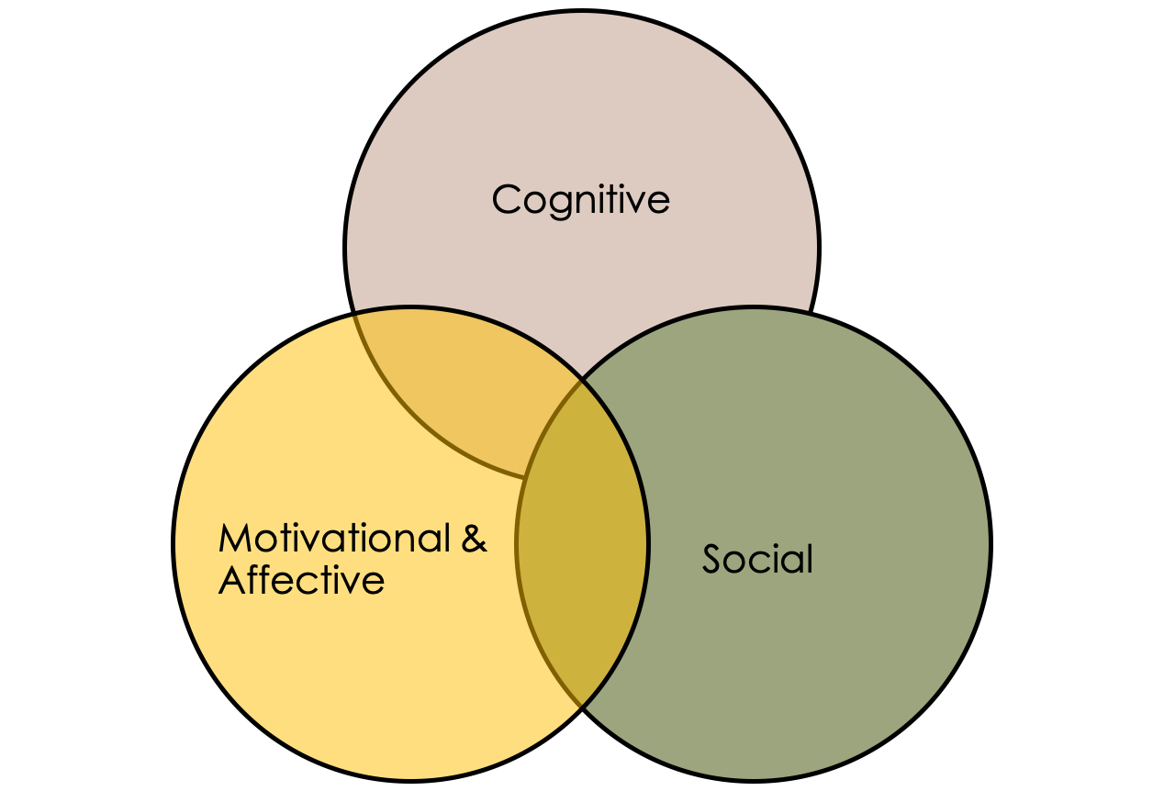
Understand Students’ Learning Challenges
During the process of learning, students may experience a variety of cognitive, motivational or affective challenges that affect their learning.
The three areas are interrelated, and many challenges students face during learning stem from an interaction of cognitive, motivational/affective and social factors. Students will enter the classroom with prior knowledge/experiences and learning strategies, and this, combined with experiences in the current course/classroom dynamics, may affect their motivation to learn.

Slide 21

Identifying the Problem
Upon completion of the inventory, take a few moments to identify the “big problems” students experience in your course.
As an instructor, one of the first steps to supporting student learning is identifying the instructional challenges that can arise when students are learning the content and developing intellectual skills needed in their disciplines.
Keeping the course you identified above in mind, you can complete the Instructional Challenges Inventory.
You will rate instructional challenges in your class on a scale ranging from “not a problem” to “a big problem”.
Image Source: https://www.123rf.com

Slide 22
Identify Prior Knowledge and Prior Experience
Students come into our course with a broad range of backgrounds, educational experiences, and prior knowledge and skills.
Current research on learning suggests that learning is determined by what the learner already knows about the topic or related topics.
If the pre-existing knowledge is correct and consistent with the new information, the effect on learning is positive. However, if prior knowledge is full of misconceptions, or conflicts with new information, the effect on new learning can be negative.

Slide 23

No ‘Best Practice’ For Online Course Design
However, there is no ‘best practice’ for online course design, because this is contextual to each teaching and learning situation and discipline area.
The starting point should be understanding student needs, developing engaging activities, building a sense of community, no ‘best practice’ for online course design employing discussion and reflections during presentations, providing tips, hints and tools for achieving these goals.
  Image Source: http://clipart-library.com/clipart/504328.htm
We should consider the content, purposes, and instructional strategies as well as how the instruction is represented and controlled through available technology tools.

Slide 24
References
[1] Active Learning Cheat Sheet. 10 Steps to getting started
[2]Barnes, D.(1989). Active Learning. Leeds University TVEI Support Project.
[3] Biggs, J. (2003). Aligning teaching for constructing learning, HEA.
[4] Biggs, J. (2014). Constructive alignment in university teaching. HERDSA Review of Higher Education, 1, 5-22.
[5] Bonwell, C. C., & Eison, J. A. (1991). Active learning: Creating excitement in the classroom. ASHE-ERIC Higher Education Report No. 1. Washington, DC: The George Washington University.
[6] Brame, C. (2016). Active learning. Vanderbilt University Center for Teaching. Retrieved [todaysdate] from https://cft.vanderbilt.edu/active-learning/.
[7] Brown, A. (2014). Implementing active learning in an online teacher education course, American Journal of Distance Education, 28(3), 170–182
[8] Budhai, S. S.; Brown Skipwith, K. A. (2022). Best practices in engaging online learners through active and experiential learning strategies. Routledge.
[9] Cranton, P. (2012). Planning instruction for adult learners (3rd ed.). Toronto: Wall & Emerson.

Slide 25
References
[10] Ertmer, P. A., & Ottenbreit-Leftwich, A. (2013). Removing obstacles to the pedagogical changes required by Jonassen's vision of authentic technology-enabled learning. Computers & Education, 64, 175–182.
[11] Garrison, D. R., Anderson, T., & Archer, W. (2000). Critical inquiry in a text-based environment: Computer conferencing in higher education. The Internet and Higher Education, 2(2–3), 87−105.
[12] Grabinger, S., Dunlap, J. (1995). Rich environments for active learning: a definition. Research in Learning Technology, 3 (2): 5–34.
[13] Hamilton, E. R., Rosenberg, J. M., & Akcaoglu, M. (2016). The substitution augmentation modification redefinition (SAMR) model: A critical review and suggestions for its use. TechTrends, 60(5), 433–441.
[14] Harasim, L. (2017). Learning theory and online technologies (2nd ed.). New York: Routledge.
[15] How to Plan Effective Lessons for Your Online Classroom
[16] Jonassen, D. H. (1996). Computers in the classroom: Mindtools for critical thinking. Prentice-Hall, Inc.

Slide 26
References
[17] Koehler, M., & Mishra, P. (2009). What is technological pedagogical content knowledge (TPACK)?. Contemporary Issues in Technology and Teacher Education, 9(1), 60–70.
[18] Moersch, C. (1995). Levels of technology implementation (LoTi): A framework for measuring classroom technology use. Learning and Leading with Technology, 23, 40–42.
[19] Open University (n.d). Active learning: making learning engaging.
[20] Panitz, T. (December 1999). Collaborative versus cooperative learning: a comparison of the two concepts which will help us understand the underlying nature of interactive learning.
[21] Sivan, A., Leung, R.W., Woon, C. and Kember, D. (2020). An implementation of active learning and its effect on the quality of student learning. Innovations in Education and Training International, 37 (4), 381–389.
[22] West, R. E. & Allman, B. (2021). Designing Technology- Enhanced Learning Experiences. In J. K. McDonald & R. E. West (Eds.), Design for Learning: Principles, Processes, and Praxis. EdTech Books. https://edtechbooks.org/id/designing_technology

Slide 27


Thank you for attention

