Slide 1


Online Learning Strategies and Models
Sirje Virkus (sirje.virkus@tlu.ee) https://www.assistant-erasmus.eu

Slide 2
Principles of Effective Online Teaching
be aware of key concepts and types of tools,
consider what is known about these,
to have an approach that allows you to trial ways of teaching online and to understand the results (OU, 2017).

Slide 3
Principles of Effective Online Teaching
Create a schedule
Ask for feedback
Recognise diversity (OU, 2017).
Keep learners informed
Foster a sense of community

Slide 4

Create a Schedule
Provide a schedule of expectations to learners – tell them by when you consider they should have reached each milestone in the course and follow up when students miss core deadlines (OU, 2017).
When moving to an asynchronous online learning environment it is tempting for students to expect that the teacher should be always available.
You need to establish a set schedule of when you are, and are not, available to learners.
If they will need synchronous support, drop-in tutorials can be scheduled.
Image Source: https://icon-library.com

Slide 5

Keep Learners Informed
If there is to be a change to planned activities, for example if you will be away and unable to respond to messages for a few days, make sure the learners are kept informed well in advance, and designate an alternate person the learners can contact if they need assistance urgently (OU, 2017).
Make sure you repeat information about core deadlines often.
If there are to be synchronous learning events (such as webinars and group tutorials) make sure learners are reminded of the event several times in the weeks and days leading up to each event.
Image Source: https://icon-library.com

Slide 6

Foster a Sense of Community
Building community is important for online learning, where learners can readily drift away or feel isolated due to the nature of online engagement. So think about steps to keep them together and engaged.
In an online environment, the role of the teacher can become more supportive and collegiate, such that the learners understand that your primary role is to help them to succeed on the course. It can be useful to construct an individual relationship with each learner rather than always relying on mass or automated emails (OU, 2017).
Image Source:
https://icon-library.com

Slide 7

Ask for Feedback
You need to check at regular intervals how the learners are doing, evaluate their progression through the course materials, and ensure they are being supported.
Those who respond negatively, and those who do not respond at all, will need your attention to help them develop study strategies to get them back on track.
Online feedback mechanisms can provide more formative feedback for tutors than traditional paper questionnaires (Donovan et al., 2006).
It can also be very beneficial to engage in peer observation with fellow online teachers (Jones and Gallen, 2016, OU, 2017).
Image Source:
https://icon-library.com

Slide 8

Recognise Diversity
However, this might need to be considered in light of the value of giving learners some shared structure to follow (OU, 2017).
One of the main advantages of the online environment is that students can learn in their own way and pace. Try not to curtail the freedoms that online study offers by imposing unnecessary limitations on the way students undertake their learning.
Differentiated instruction is important here. Online instructors can usefully tailor their instruction according to factors such as the individual’s ability or interests (Beasley and Beck, 2017).
Image Source:
https://icon-library.com

Slide 9
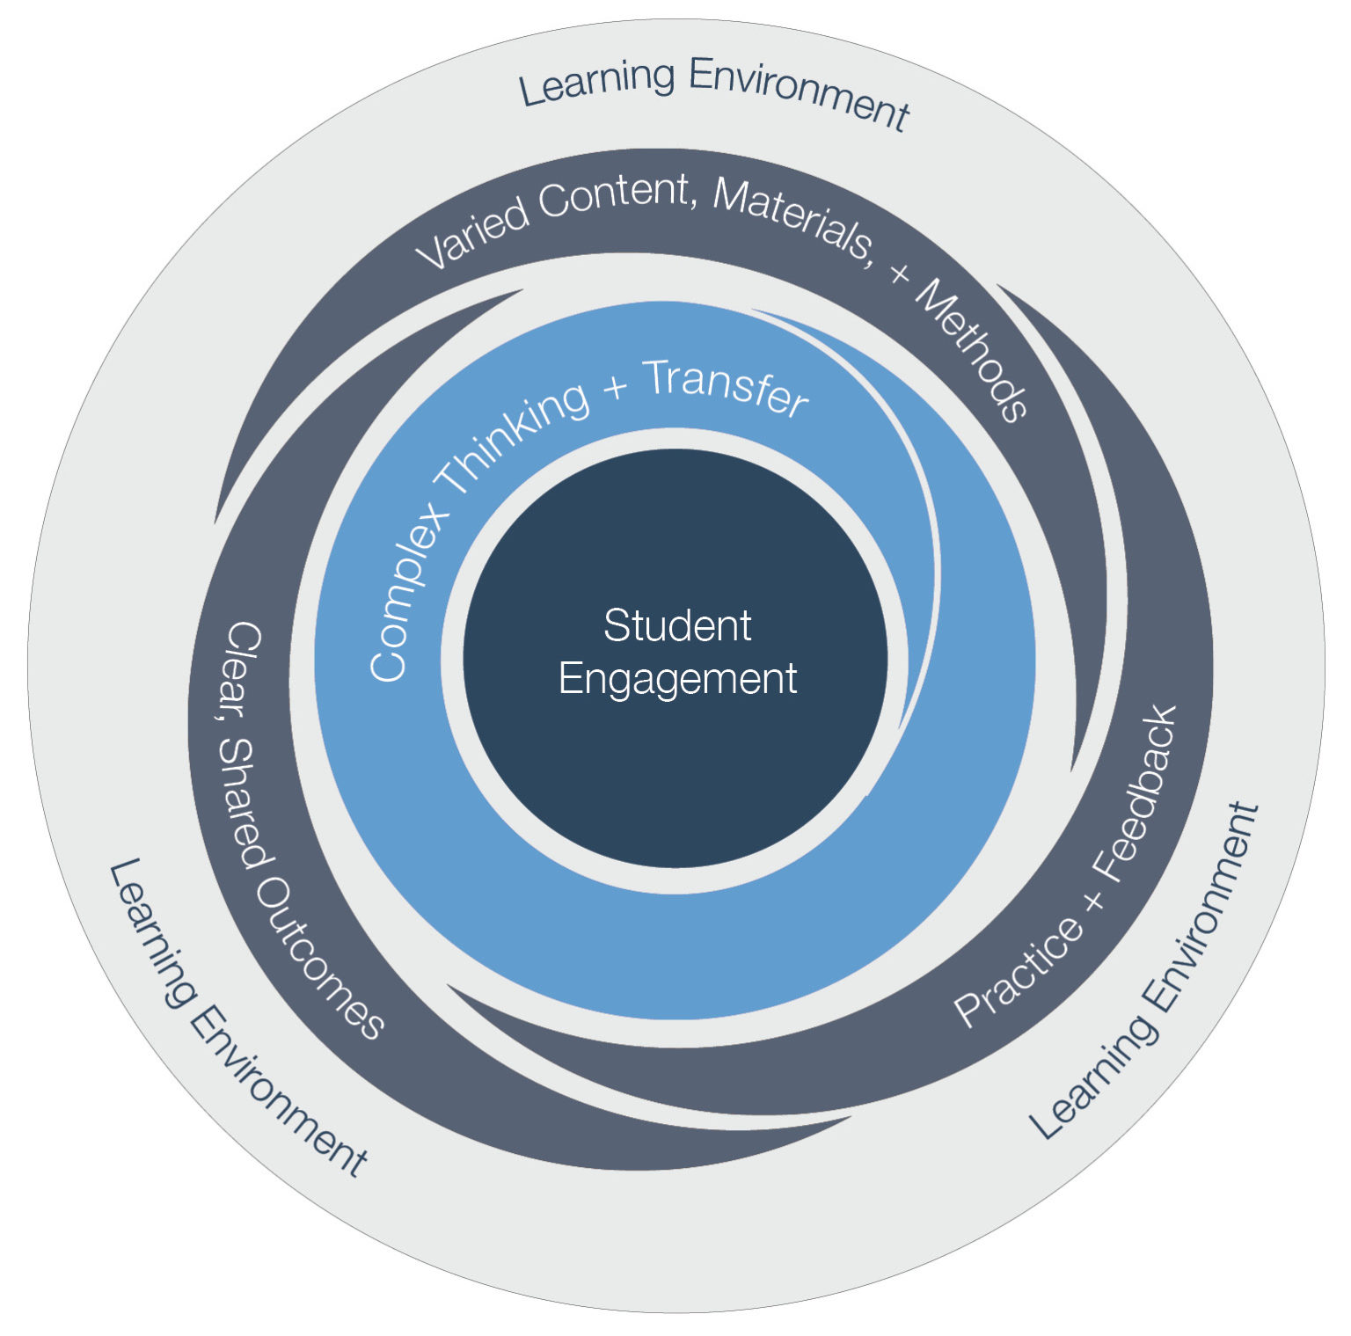
Elements of Effective Instruction Framework
The Elements of Effective Instruction Framework by the Great Schools Partnership outlines five intertwined elements of instructional practice that complement and enhance one another:
  Learning environment
  Clear, shared outcomes
  Varied Content, Materials and Methods
  Practice & Feedback
  Complex Thinking + Transfer
When integrated into learning experiences, these elements foster student engagement with the ultimate goal of improving student outcomes and achievement.

Slide 10
References
[1] Ausubel, D.P. (1960). Use of advance organisers in the learning and retention of meaningful material. Journal of Educational Psychology, 51 (5), 267–72.
[2] Beasley, J.G. and Beck, D.E. (2017). Defining Differentiation in Cyber Schools: What Online Teachers Say. TechTrends, 61 (6), 550–59.
[3] Bruner, J.S. (1966). Toward a Theory of Instruction, Cambridge, MA, Harvard University Press.
[4] Donovan, J., Mader, C.E. and Shinsky, J. (2006). Constructive student feedback: Online vs. traditional course evaluations. Journal of Interactive Online Learning, 5 (3), 283–96.
[5] Great School (2020). Partnership. The Elements of Effective Instruction.
[6] Jones, M.H. and Gallen, A-M. (2016). Peer observation, feedback and reflection for development of practice in synchronous online teaching. Innovations in Education and Teaching International, 53 (6),616–26.

Slide 11
References
[7] Open University (2017). Take your teaching online. The Open University.
[8] Piaget, J. (1957) ‘The Child and Modern Physics’, Scientific American, vol. 196, no. 3, pp. 46–51.
[9] Skinner, B.F. (1968) The Technology of Teaching, New York, NY, Appleton-Century- Crofts.
[10] Thorndike, E.L., Bregman, E.O., Tilton, J.W. and Woodyard, E. (1928) Adult Learning, New York, NY, Macmillan.
[11] Siemens, G. (2005) ‘Connectivism: A Learning Theory for the Digital Age’, International Journal of Instructional Technology and Distance Learning, vol. 2, no. 1 [Online]. http://www.itdl.org/journal/jan_05/article01.htm
[12] Vygotsky, L.S. (1986) Thought and Language (trans. from Russian and revised and edited by A. Kozulin), Cambridge, MA, MIT Press.
[13] Wenger, E. (1998). Communities of practice: Learning as a social system. Systems Thinker, 9(5), 2-3.

Slide 12


Thank you for attention

