Slide 1


Historical Background and Evolution of Digital Education
Sirje Virkus (sirje.virkus@tlu.ee) https://www.assistant-erasmus.eu

Slide 2

The Beginnings of Digital Education
Traditional Methods of Education
Limited Access to Learning Resources
Teacher-centred Approach

Slide 3

Emergence of Educational Technology
Introduction of Early Educational Technologies (e.g., Projectors, Radio, Television)
Initial Attempts at Computer-Based Learning
3
Notes:
3

Slide 4

Advent of the Internet and Web
Impact of the Internet and Web on Education
Introduction of Online Learning Platforms
Shift towards Digital Content Creation

Slide 5

Development of Learning Management Systems (LMS)
Evolution of LMS from Simple Platforms to Comprehensive Systems
Role of LMS in Facilitating Online Education

Slide 6
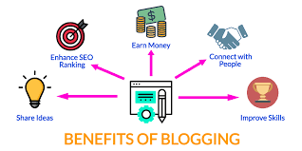
Blogs
Blogging’s role in educational technology
Democratization of publishing
Impact of blogs on academic discourse and identity
Networked Participatory Scholarship (NPS)
Advocacy for data privacy and independence
Expansion of blogging to students
Academic culture and online engagement

Slide 7

Social Media
Introduction to social media in education
Benefits and challenges of social media use
Potential uses of social media in teaching and learning
Navigating fake news and misinformation
Blurring of professional and personal spheres
Context collapse and its implications for education

Slide 8
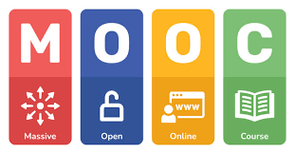
Rise of Massive Open Online Courses (MOOCs)
Definition and characteristics of MOOCs
Contribution to global access to education
Challenges and opportunities

Slide 9

Integration of Artificial Intelligence (AI)
AI's role in personalized learning
Use of AI in adaptive learning systems
Ethical considerations

Slide 10

Mobile Learning (M-Learning)
Growth of mobile devices in education
Benefits of M-Learning for accessibility
Examples of M-Learning applications

Slide 11

Future Trends and Conclusion
Predictions for the Future of Digital Education
Importance of Continuous Adaptation

Slide 12
References
Collis, B., & Moonen, J. (2001). Flexible learning in a digital world. London: Kogan Page.
Jung, I. (Ed.). (2019). Open and distance education theory revisited. Singapore: Springer.
Kirkwood, A., & Price, L. (2014). Technology-enhanced learning and teaching in higher education: what is ‘enhanced’and how do we know? A critical literature review. Learning, Media and Technology, 39(1), 6-36.
Vaughan, N. D., Cleveland-Innes, M., & Garrison, D. R. (2013). Teaching in blended learning environments: Creating and sustaining communities of inquiry. Athabasca University Press.
Veletsianos, G., VanLeeuwen, C., Belikov, O. & Johnson, N. (2021). An Analysis of Digital Education in Canada in 2017-2019. International Review of Research in Open and Distributed Learning, 22(2), 102–117. https://doi.org/10.19173/irrodl.v22i2.5108
Weller, M. (2022). The Rise and Development of Digital Education. In Handbook of Open, Distance and Digital Education (pp. 1-17). Singapore: Springer Nature Singapore.
Zawacki-Richter, O., & Jung, I. (Eds.). (2023). Handbook of Open, Distance and Digital Education. Springer.Zawacki-Richter, O., & Jung, I. (Eds.). (2023). Handbook of Open, Distance and Digital Education. Springer.

Slide 13


Thank you for attention

