Slide 1


Big Air Quality Data Challenge: case of Romania (RO)
Team: Name Surname, Name Surname, Name Surname…

Slide 2
Research questions
Essential Question #1: Which months are the coldest and the hottest in the chosen country?
  Guided Question A: Which descriptive statistics could be useful for this analysis?
    Answer to Question: mean / median
  Guided Question B: What kind of plot could be used to answer essential question?
    Answer to Question: summarizing distribution with box-plot
Essential Question #2:
  Guided Question A:
  Guided Question B:

Slide 3
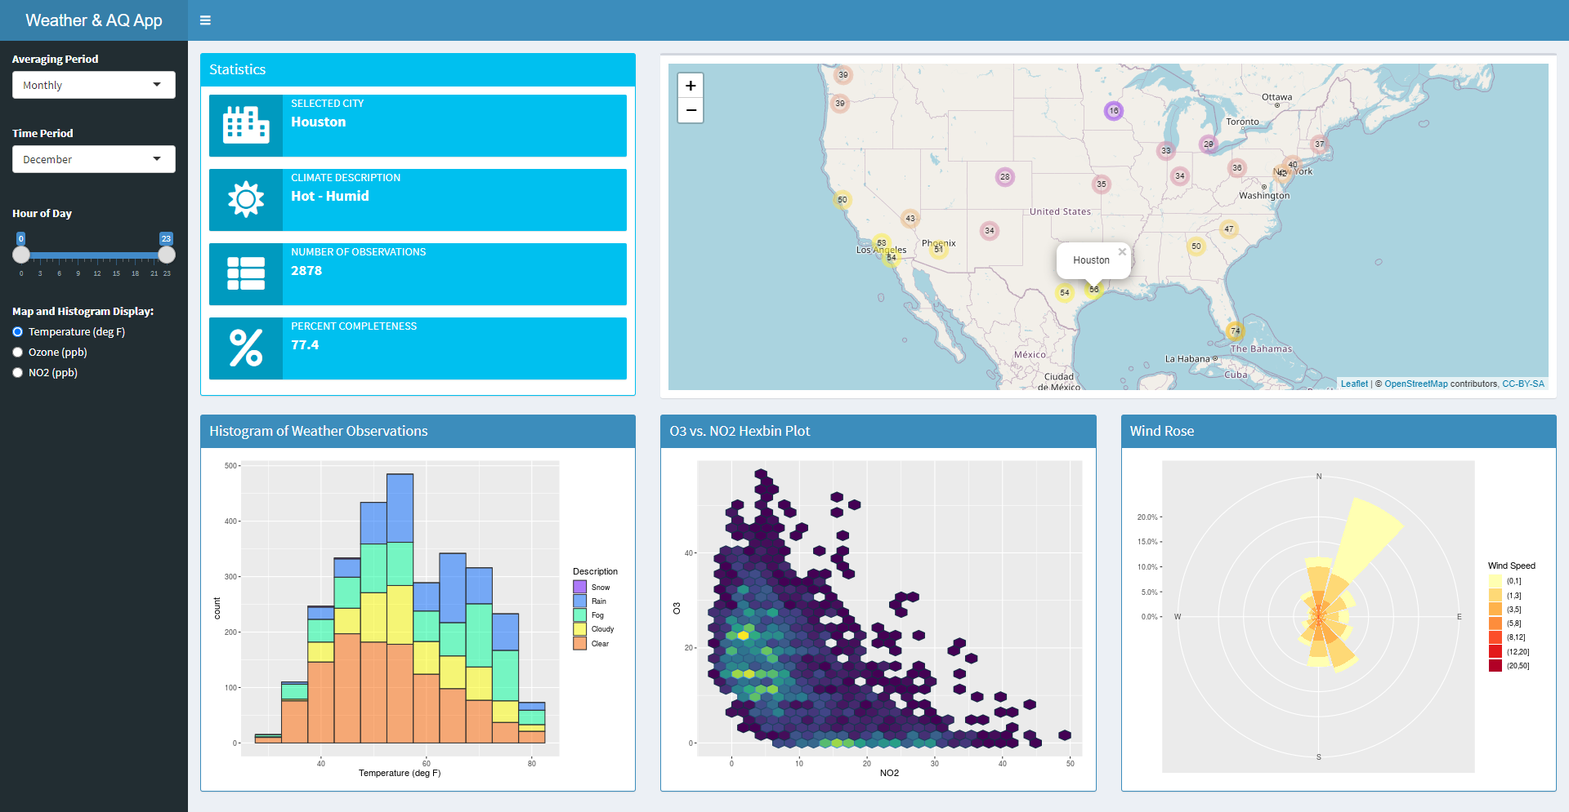
Presenting solution: https://nwtang.shinyapps.io/weather

Slide 4
Research conclusions
Conclusion #1: Answering essential question #1.
  Insights for City A:
  Insights for City B:
Conclusion #2: Answering essential question #2.
  Insights for City A:
  Insights for City B:

Slide 5
Self-assessment of the solution = 10/15 = 66.66%
Criteria | Levels: 0 1 2 3
Architecture of solution: | nothing was found for this criterion | plots in slides, Power BI, .html from Colab or Markdown | .html from R flexdashboard, Python jupyter-flex or Panel | link to dashboard by Shiny, Dash, Panel, Streamlit, Gradio, etc.
Objects of analysis: | nothing was found for this criterion | a single city is analysed | 2-3 cities are analysed | any city can be selected
Scope of analysis: | nothing was found for this criterion | insights made from analysis of historical data | historical insights, univariate forecasting, no backtesting | historical insights, multivariate forecasting, backtesting
Visualizations: | nothing was found for this criterion | only one type of plot was used | several types of plots were used | plots, drop-down lists, tabs, sidebar, etc.
Questions/conclusions: | nothing was found for this criterion | single question/conclusion | 2-3 questions/conclusions | many questions/conclusions

