Slide 1
ICT in Higher Education in Lithuania
Gytis Cibulskis, KTU
Ramunas Kubiliunas, KTU
Saulius Preidys, VU

Slide 2
Course Goal
To gain knowledge and skills of selecting the modern strategies of ICT application in Higher Education by using advantages of ICT infrastructure according to the case of Higher Education development in Lithuania

Slide 3
Learning Outcomes
After this course you will be able to:
Select the investment strategies for Higher Education development according to the case of Lithuanian advantages and disadvantages
Interpret the application of ICT in Higher Education according to main advantages of ICT infrastructure

Slide 4
Content
About Lithuania
HE in Lithuania
Coordination of ICT development
Services provided by LieDM
The application of ICT in Higher Education
Final Quiz
Please select the part which you are interested in

Slide 5
Lithuania
The first people settled in the territory of Lithuania after the last glacial period in the 10th millennium BC
The first known record of the name of Lithuania (Lithuanian: Lietuva) is in a 9 March 1009 story of Saint Bruno recorded in the Quedlinburg Chronicle (slide 6)

Slide 6

Name of Lithuania
Notes:
Lithuania's name in writing 1009

Slide 7
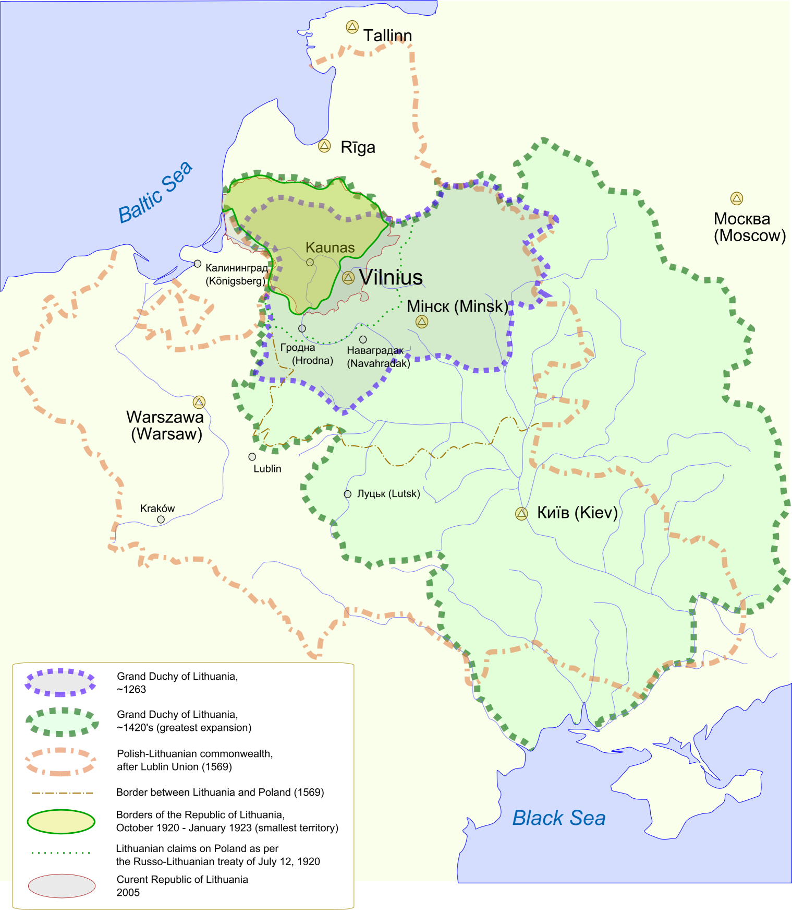
Lithuania
During the 10–11th centuries, Lithuanian territories were among the lands paying tribute to Kievan Rus', and Yaroslav the Wise was among the Ruthenian rulers who invaded Lithuania (from 1040)
The territory of Lithuania was changing during a time

Slide 8
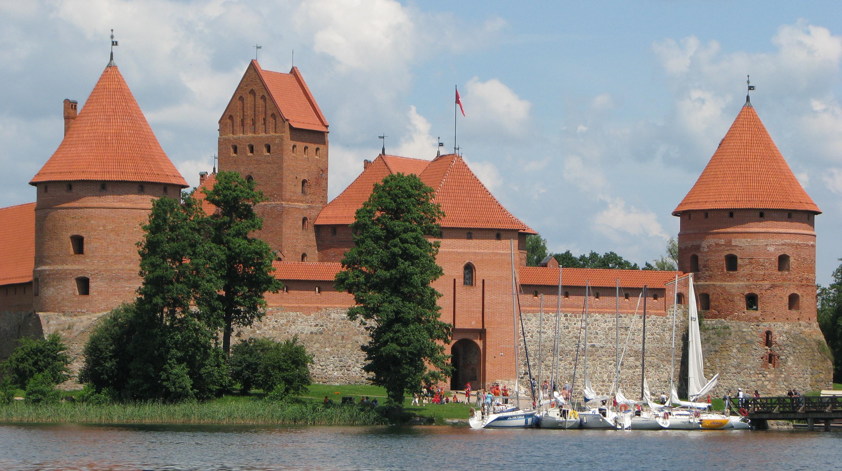
Trakai Island Castle, the former residence of the Grand Dukes

Slide 9


Nowadays Lithuania
Lithuania, officially the Republic of Lithuania is a country in the Baltic region of northern-eastern Europe

Slide 10
Nowadays Lithuania
Population 2017 estimate 2,8Mln
Total Area 65,300 km2
The official language, Lithuanian, along with Latvian, is one of only two living languages in the Baltic branch of the Indo-European language family
Most students in higher education institutions in Lithuania are Lithuanian and learn in Lithuanian language, although number of international students is constantly increasing in recent years

Slide 11
Quiz 1
Which aspect of Lithuania is a challenge for higher education development?
  Size of Lithuania
  Population of Lithuania
  National language of Lithuania
Which aspect of Lithuania is helpful for nowadays higher education development?
  Size of Lithuania
  Population of Lithuania
  National language of Lithuania

Slide 12
1a or 2a
Size is an advantage because it’s easy to develop a network infrastructure.
Lithuania has one of the best broadband internet infrastructures in the World and the fastest public WiFi
Back to content

Slide 13
1b, 1c or 2b, 2c
Population or use of national language are the main challenges
Small population is sensitive to demographic changes
Unique language makes barriers for collaboration with international
Back to content

Slide 14
Higher Education in Lithuania
There two types of higher education institutions:
  Universities, academies or seminary representing university sector of higher education
  Colleges of higher education representing non-university higher education sector
Universities offer university level degree granting studies and award Bachelor’s, Master’s, Doctoral degrees
Colleges offer college level degree granting studies and award Professional Bachelor’s degrees. Both universities and colleges can also offer non-degree granting studies
All institutions of HE are connected to Lithuanian Science and Research Network (LITNET) and are able to use national ICT infrastructure and information resources

Slide 15
Quiz 2
How would you better facilitate progress of Higher Education by exploiting advantages of Lithuania:
By modernizing organizational infrastructure of HE institutions focusing on number of Lithuanian students
By modernizing ICT infrastructure and services focusing on collaboration of HE institutions

Slide 16
2a, 2b
Modernization of organizational infrastructure is also important
However investments in modern ICT infrastructure:
  brings higher added value
  creates better opportunities for local and international collaboration
  helps attract more international students and teachers
Back to content

Slide 17
Coordination of ICT Development in HE
Coordination at a national level is performed through the 2 government programs:
  “Lithuanian Education and Research Network (LITNET)” and
  “Information Technologies for Science and Studies (LITMIS)”.
LITMIS went through the several stages in the past 20 years and now is governed through 3 consortia’s:
  Education Information Association (EDINA)
  Lithuanian Academic Libraries Consortia (eLABa)
  Lithuanian Distance Education Network (LieDM)

Slide 18
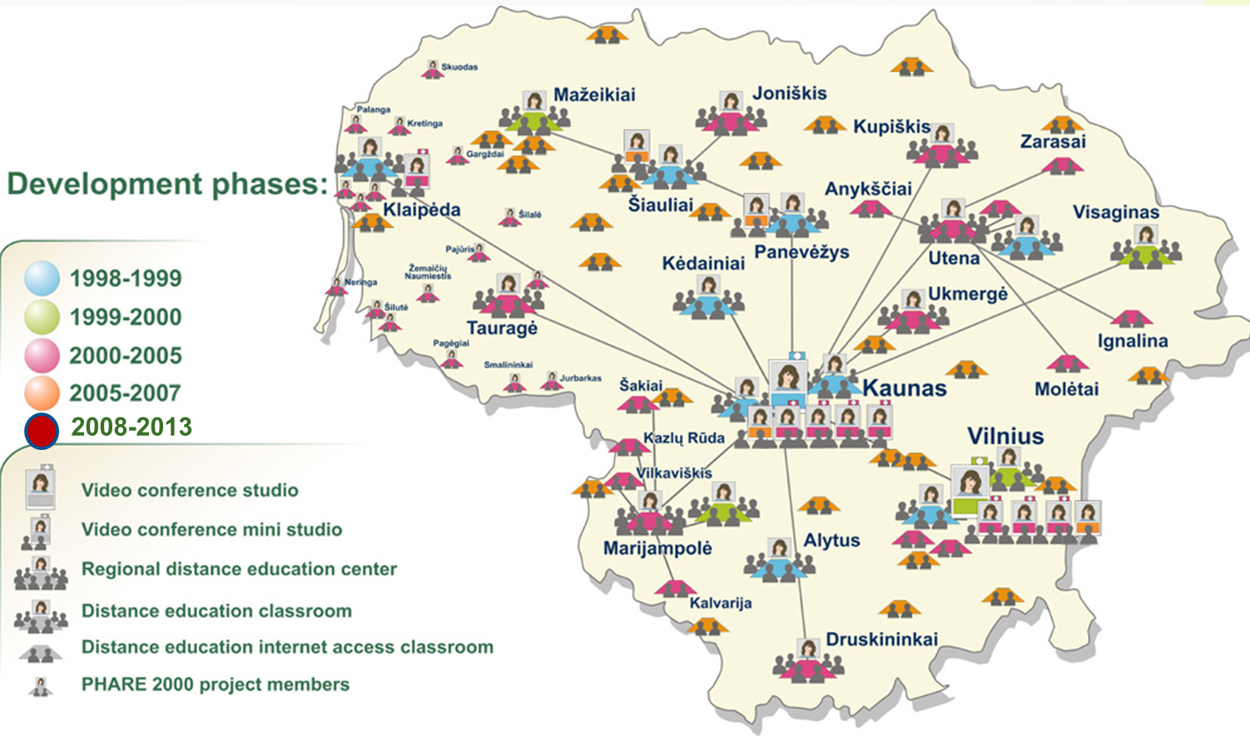
Lithuanian Distance Education Network (LieDM) Consortia

Slide 19
LieDM Consortia provides with
Multi-institutional Moodle installation that implements functionality of most advanced open source Learning Management System
Centrally supported Vidyo infrastructure that ensures desktop videoconferencing services
Web conferencing / virtual classroom system that allows to deliver and record live interactive lectures
This helps smaller institutions to avoid costs of own servers and system administrators, having always up-to date services.

Slide 20
Adobe Connect
Is actively used in distance learning master program “Information Technologies of Distance Education” at Kaunas University of Technology
Students actively participate in virtual lectures connected from remote places (sometimes even from abroad)
Teachers divide students into groups for active discussions during the lectures
Outcomes of active discussions are introduced to all groups and gained knowledge is validated through short quizzes
Recording of the lecture is usually divided into several parts

Slide 21
MOODLE
For students who are not able to attend virtual lectures, learning material and links to recordings are provided in Moodle
Only the first part of the lecture is provided to the students
In order to see further parts of the lecture, students have to reflect in discussion forums according to the tasks presented for separate groups during the lecture
Students are able to see reflections of other students in discussion forums only after their submission
Students who attended virtual lectures are able to reach all material, and recordings without need to reflect in discussion forums

Slide 22
Final Quiz
How would you implement ICT application in your institution if you are not sure if your students will be able to participate in face to face lectures?
According to main advantages of ICT infrastructure in your country you would:
  Organize lectures in the virtual classroom system and make recordings
  Provide learning material and links to the recordings in the virtual learning environment
  Evaluate your students knowledge by quizzes
According to main advantages of ICT infrastructure in your country you would:
  Organize lectures with interactive tasks in the virtual classroom system
  Divide lecture recordings into separate parts according to the interactive tasks
  Provide learning material and links to the recordings separated with reflection tasks in the virtual learning environment

Slide 23
First case
The virtual classroom system and virtual learning environment enable your students to participate in lectures online or watch recordings if they were not able to participate in lecture on time
The quizzes help to evaluate the knowledge of all students
However, quizzes usually show if students remember information received during the lecture or from reading of learning material
Besides, recordings of lectures that are not divided into several parts according to active tasks gives little added value as students watch them as movies
Back to content

Slide 24
Second case
The Adobe Connect or similar virtual classroom system enables
  Students to participate actively in online lectures as they would do this in face to face lectures
  Teachers to record the lectures dividing them into separate parts according to the interactive tasks
The Moodle or similar virtual learning environment system enables
  Teachers to provide learning material and links to the recordings of lectures separating them with reflection tasks
  Students to perform reflection task personally if they were not able to participate in lectures on time and perform the tasks in groups
The knowledge and even skills of students are better evaluated in interactive / reflection tasks than in quizzes
Besides, the recordings of lectures that are divided into several parts according to active tasks students watch with higher added value
Next slide

Slide 25
You have reached the goal of the course!

