Slide 1
ICT in Higher Education in Lithuania
Notes:
Higher Education is impossible without application of ICT! However, the success of its application depends on how modern strategies and advantages of country and ICT infrastructure are used. My name is Gytis. I’m here to help you

Slide 2
Learning Outcome
To choose the application of ICT in
Higher Education (HE) according to:
Main advantages of ICT infrastructure
Case of HE development in Lithuania
Notes:
to choose the modern strategies of ICT application in Higher Education by using advantages of ICT infrastructure according to the case of Higher Education development in Lithuania.

Slide 3
1
About Lithuania
Content
2
HE in Lithuania
3
Coordination of ICT development
4
Services provided by LieDM
5
The application of ICT in Higher Education
6
Final Quiz
Please select the part which you are interested in
Notes:
In order to prove your knowledge by performing the final quiz you have to be acquainted with Lithuania, with HE organization and coordination of ICT development, with services provided and ICT application in Higher Education.

Slide 4

Lithuania
First known record of the name – 9th March 1009
Notes:
The name of Lithuania – Lietuva was mentioned for the first time in the beginning of eleventh century.

Slide 5
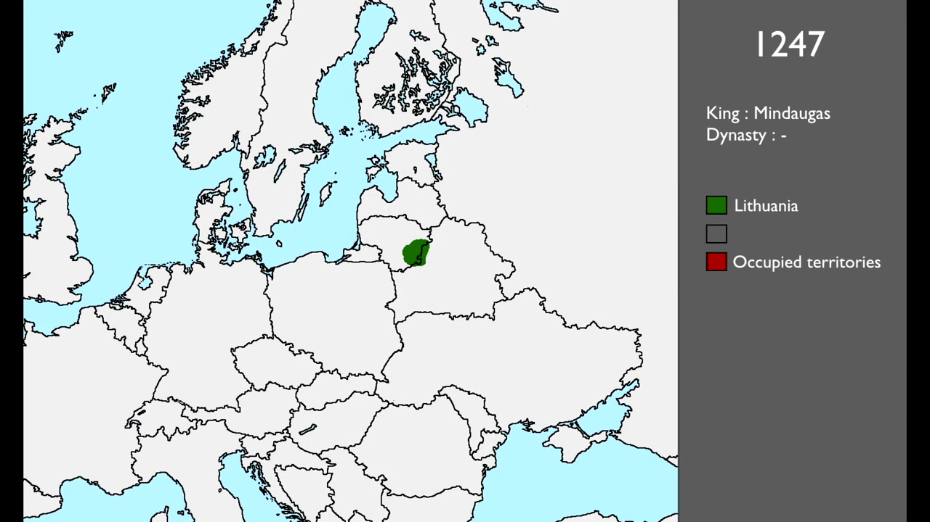
Lithuania
https://youtube.com/watch?v=Pk9GftvW5TM
Notes:
The territory of Lithuania was changing during centuries. At its peak, Lithuania was the largest state in the Europe.
Nowadays Lithuania is a small country in the Baltic region of northern-eastern Europe

Slide 6
Nowadays Lithuania
Nowadays Lithuania
Population 2017 estimate 2,8 Mln
Notes:
Population is slightly less than 3Mln

Slide 7
Nowadays Lithuania
Nowadays Lithuania
Total Area - 65,300 km²
Notes:
Total Area is sixty five thousands tree hundred square kilometers

Slide 8
Nowadays Lithuania
Nowadays Lithuania
The official language - Lithuanian
Notes:
The official language is Lithuanian - one of only two living languages in the Baltic branch of the Indo-European language family.

Slide 9
Nowadays Lithuania
Nowadays Lithuania
Most students in higher education institutions are Lithuanians
Notes:
Most students in higher education institutions are Lithuanians and study in Lithuanian language.

Slide 10
Higher Education in Lithuania
There are two types of higher education institutions:
Universities, academies or seminary
I
Colleges of higher education
II
Notes:
There are two types of higher education institutions:
Universities, academies or seminary
Colleges of higher education
Universities offer university level degree granting studies and award Bachelor’s, Master’s, Doctoral degrees
Colleges offer college level degree granting studies and award Professional Bachelor’s degrees. Both universities and colleges can also offer non-degree granting studies

Slide 11
ICT infrastructure
All institutions of HE are connected to Lithuanian Science and Research Network (LITNET)
They are able to use national ICT infrastructure and information resources
Notes:
All institutions of Higher Education are connected to Lithuanian Science and Research Network (LITNET) and are able to use national ICT infrastructure and information resources

Slide 12
Coordination of ICT Development in HE
3 consortia’s of government program “Information Technologies for Science and Studies (LITMIS)”:
        Education Information Association (EDINA)
        Lithuanian Academic Libraries Consortia (eLABa)
        Lithuanian Distance Education Network (LieDM)
Notes:
Coordination of ICT development in Higher Education is implemented through 3 consortia’s of government program “Information Technologies for Science and Studies (LITMIS)”:
1st - Education Information Association (EDINA)
2nd - Lithuanian Academic Libraries Consortia (eLABa)
and
3rd - Lithuanian Distance Education Network (LieDM) …

Slide 13
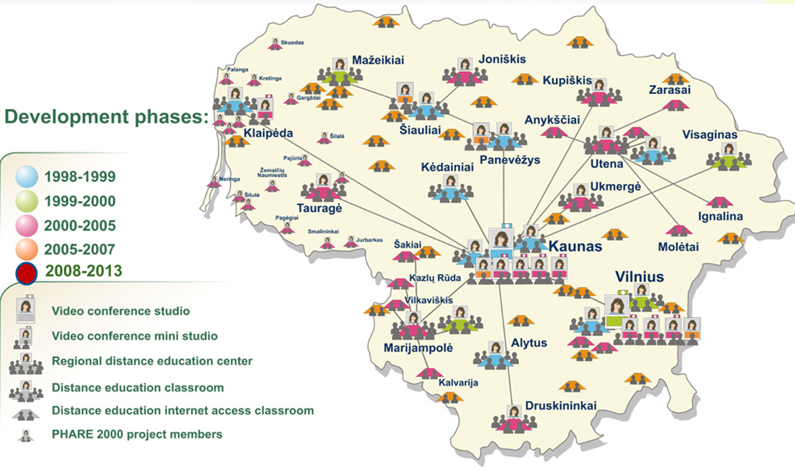
Lithuanian Distance Education Network (LieDM) Consortia
Notes:
That unites most of Universities and Colleges for coordinating:
development of e-learning infrastructure,
joined efforts in teacher training,
and creation of online learning courses.

Slide 14
LieDM Consortia provides with
LieDM Consortia provides with
This helps smaller institutions to avoid costs of own servers and system administrators, having always up-to date services.
Notes:
LieDM Consortia provides:
- with Multi-institutional Moodle installation that implements functionality of most advanced open source Learning Management System;
- with Centrally supported Vidyo infrastructure that ensures desktop videoconferencing services;
and
- with Web conferencing / virtual classroom system that allows to deliver and record live interactive lectures.
This helps smaller institutions to avoid costs of own servers and system administrators, always having up-to date services.

Slide 15
Adobe Connect
Information Technologies of Distance Education
Virtual lectures
Active discussions
Short quizzes
Lecture recording spitted into parts
Notes:
Adobe Connect is actively used in distance learning master program “Information Technologies of Distance Education” at Kaunas University of Technology.
Students actively participate in virtual lectures connected from remote places (sometimes even from abroad).
Teachers divide students into groups for active discussions during the lectures.
Outcomes of active discussions are introduced to all groups and gained knowledge is validated through short quizzes.
Recording of the lecture is usually divided into several parts.

Slide 16
Moodle
Learning material and links to recordings
1st part of the lecture is open
Further parts are opened after student’s reflections
Reflections of others are revealed after submission
Attendees of life lecture can see all parts of recording
Notes:
Moodle is used to provide learning material and links to recordings for students who are not able to attend virtual lectures.
Only the first part of the lecture is open to students.
Further parts of the lecture are opened after students reflect according to the tasks presented during the lecture.
Students are able to see reflections of other students only after their submission.
Attendees of the life lecture can see all parts of recording without the need to reflect in discussion forums.

Slide 17
Final quiz
Please accomplish the final quiz and you will reach the goal of the course!
Notes:
Please accomplish the final quiz and you will reach the goal of the course!

Slide 18
Case of ICT application in Lithuania
Active participation of students' in online lectures
Recordings of lectures as separate parts
Provided and connected learning resources with reflection tasks
Knowledge and skills evaluation in interactive reflection tasks
Recordings with higher added value
Notes:
So, let’s summarize the Case of ICT application in Lithuania.
The virtual classroom system is used:
- for Active participation of students' in online lectures;
- for Recording of lectures as separate parts.
The virtual learning environment system is used for providing and connecting learning resources with reflection tasks.
The knowledge and even skills of students are evaluated in interactive reflection tasks
The recordings with active tasks provide with higher added value.

Slide 19
You have reached the goal of the course!
Notes:
Congratulations! - You have reached the goal of the course!

